Slide 1
3D Grid Abstract
Self Portrait
Evelyn Durign-Bruce
Period 5 - Junior Architeture
Ms. Vachicouras

Slide 2
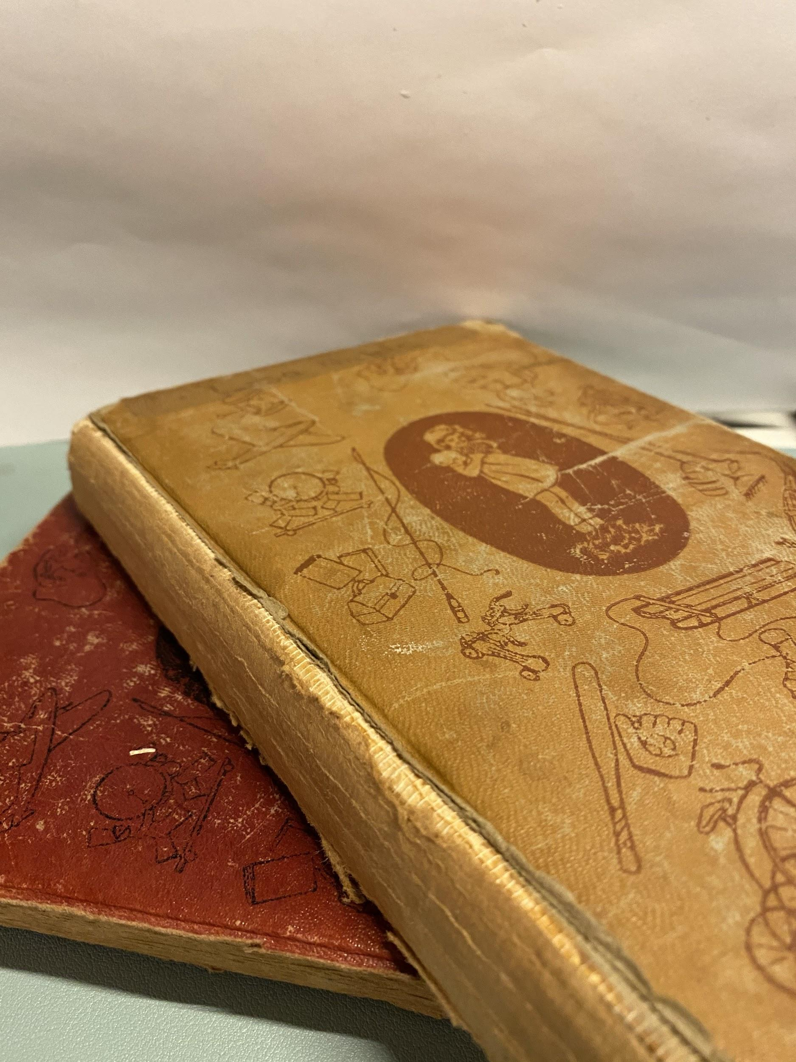
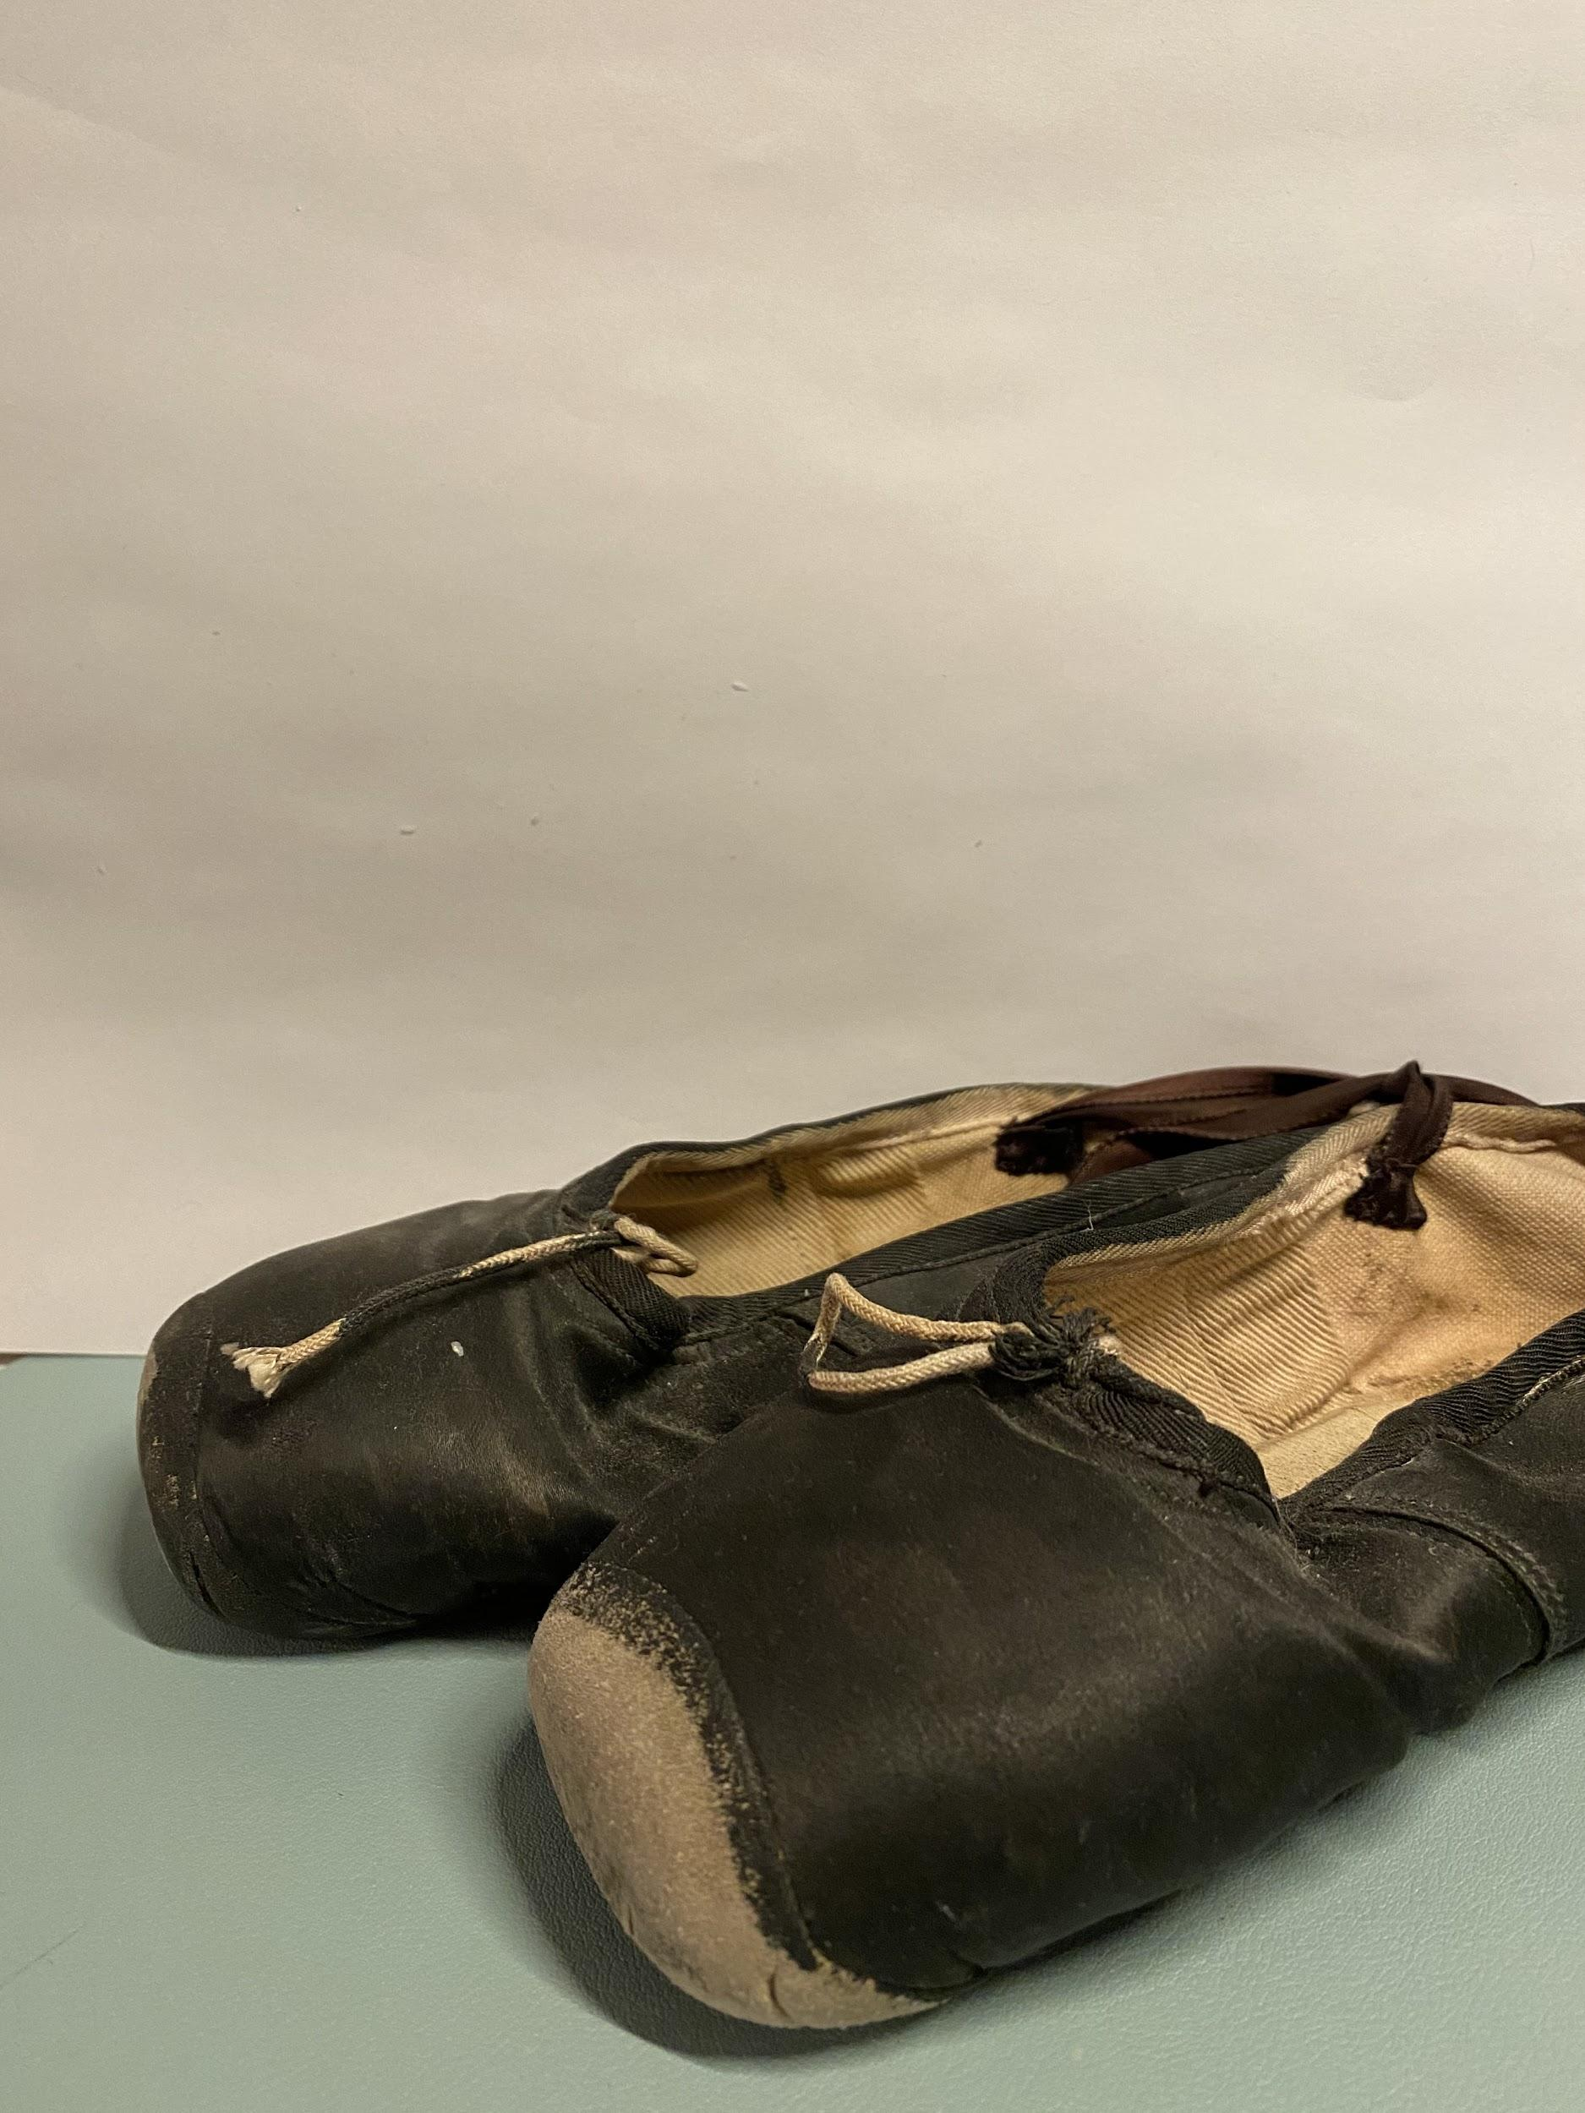
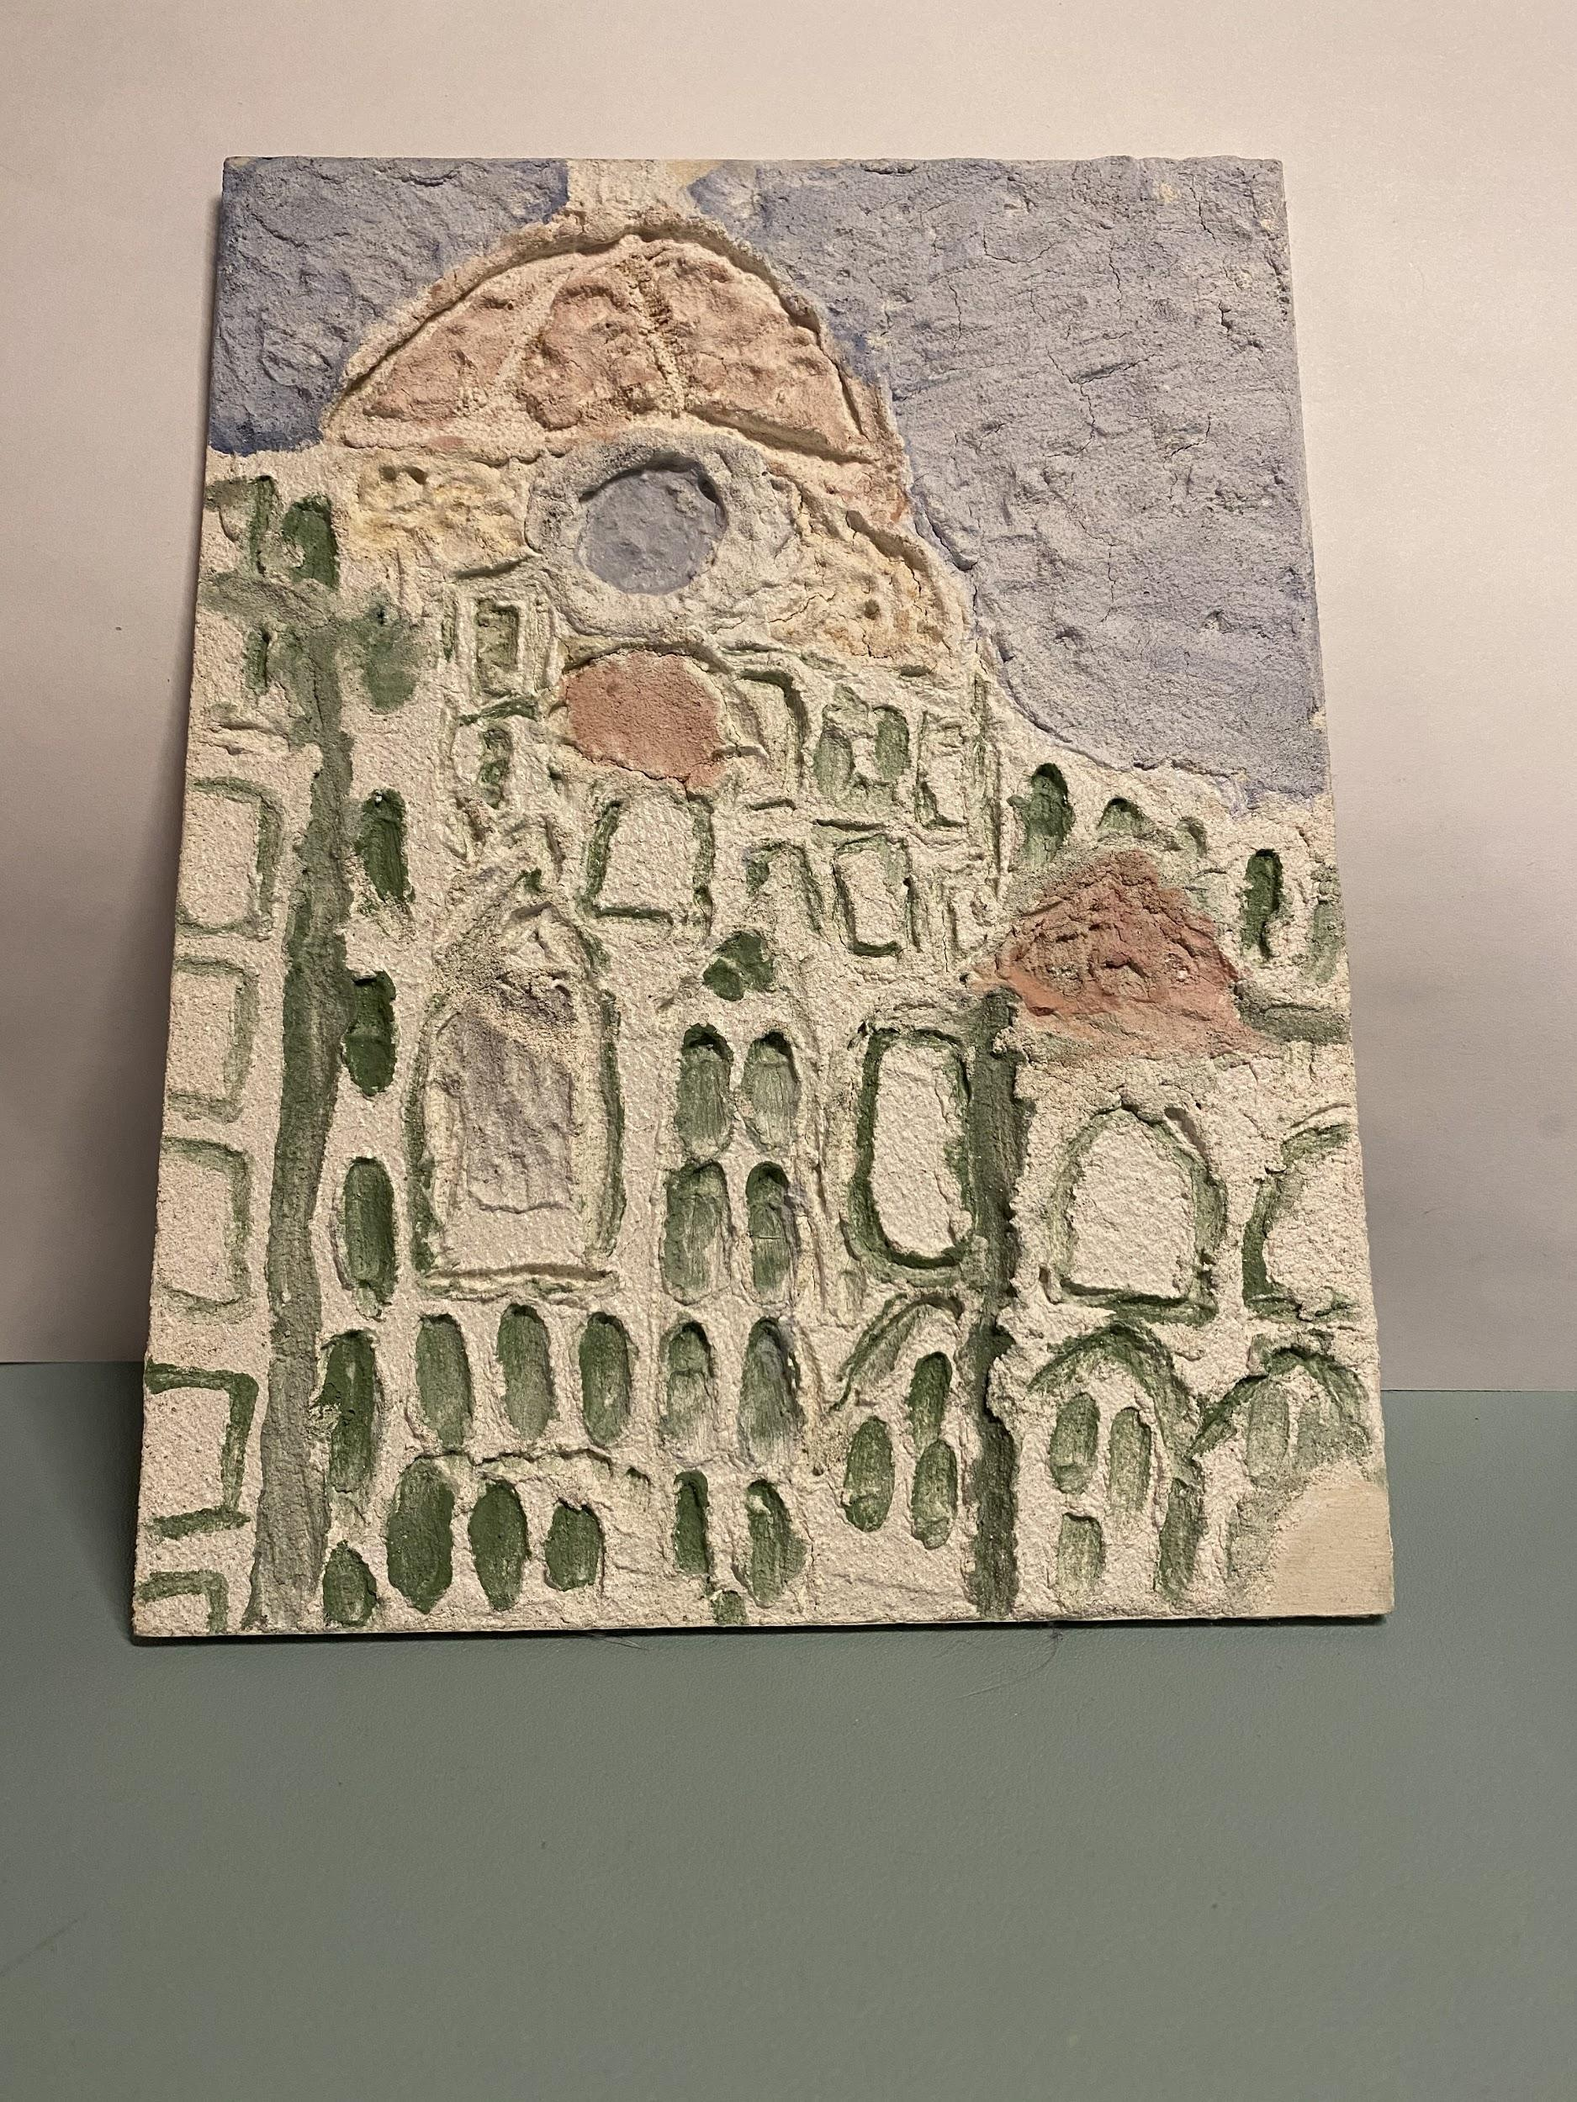
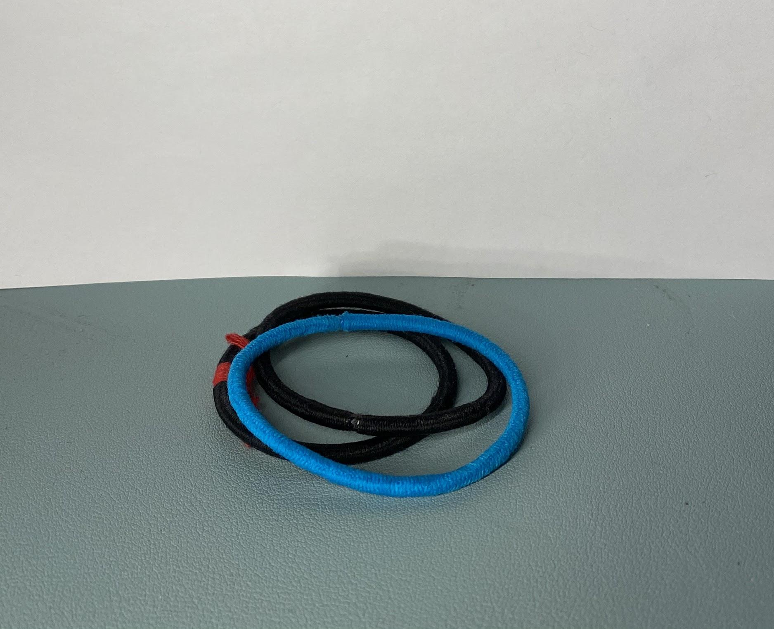
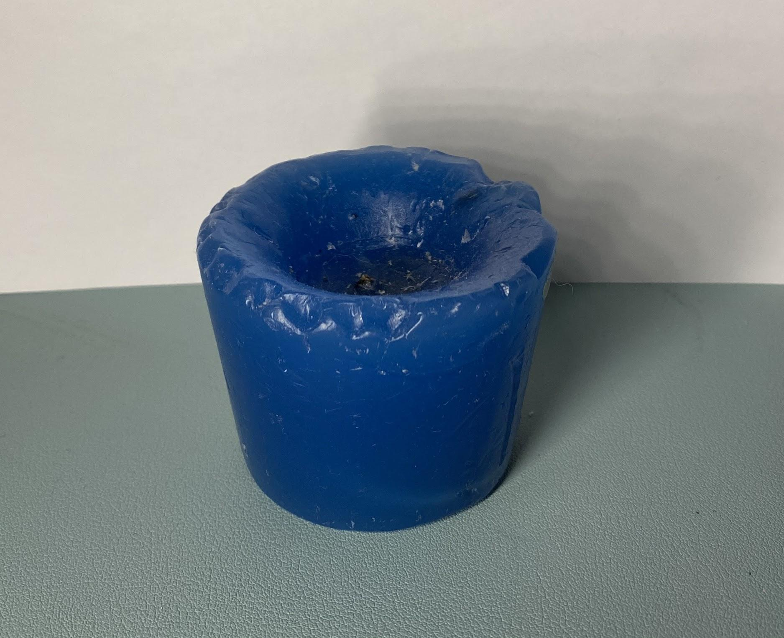
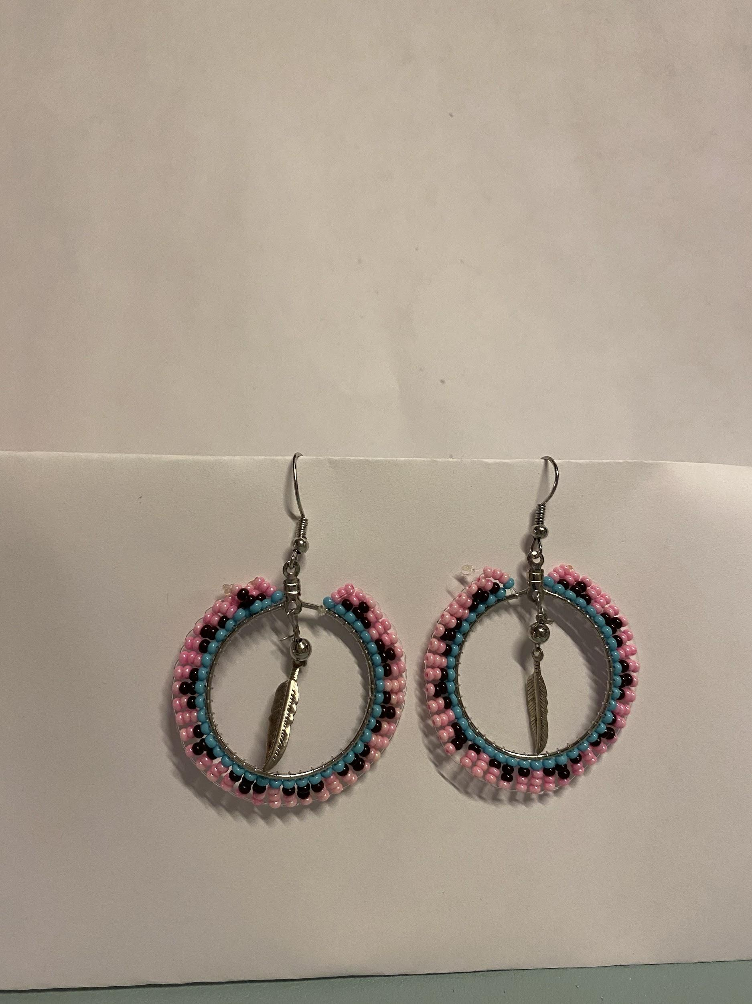
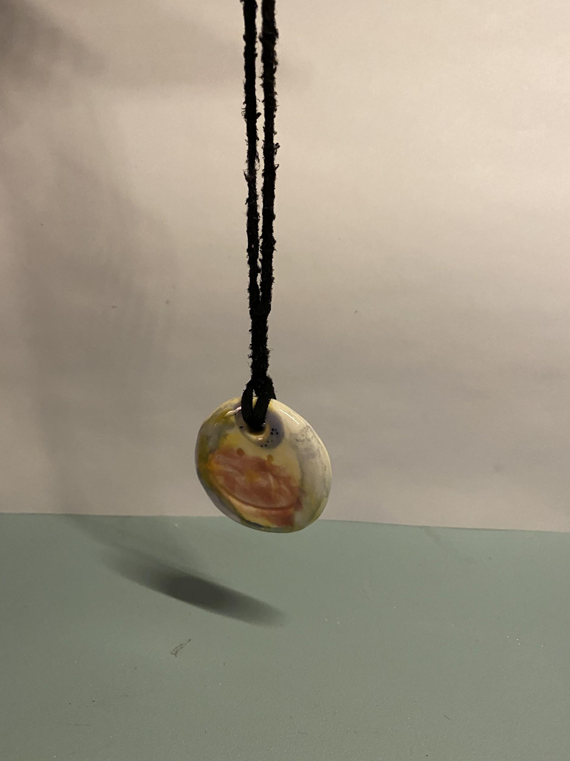
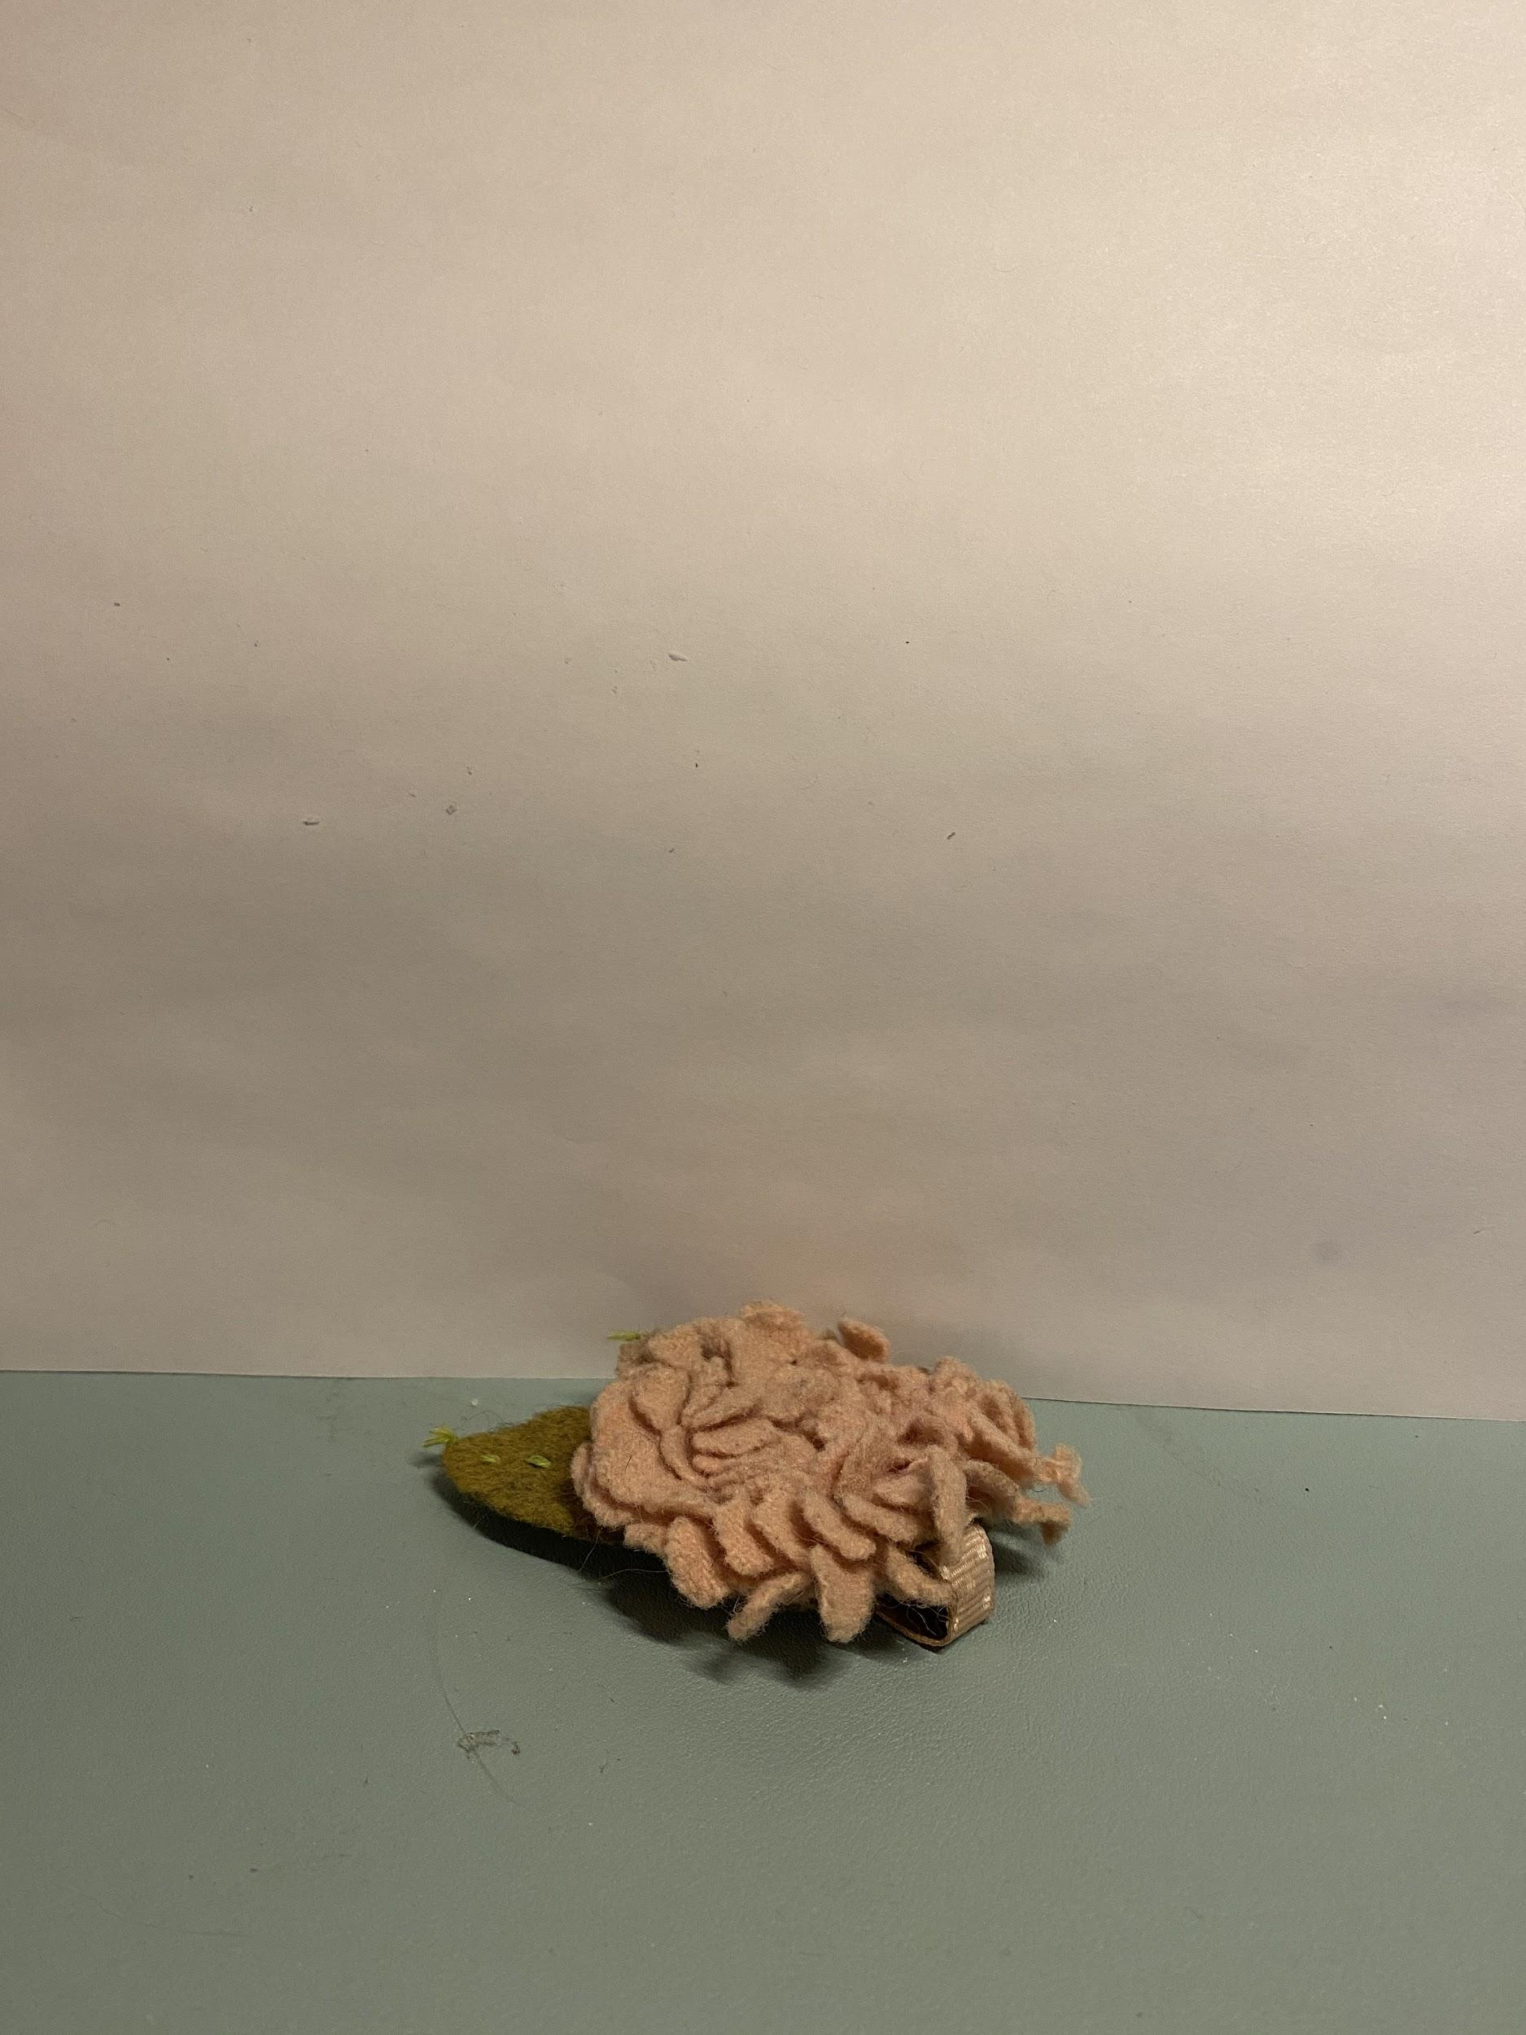
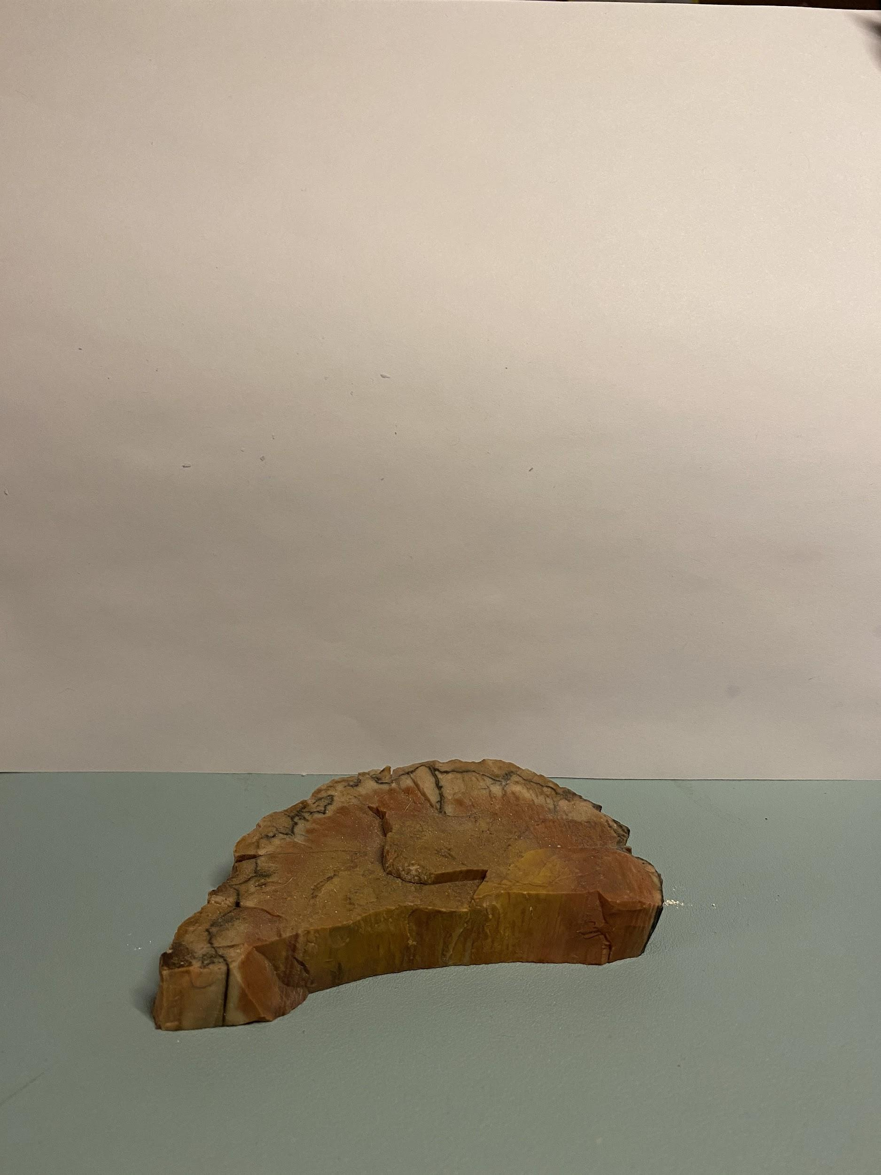
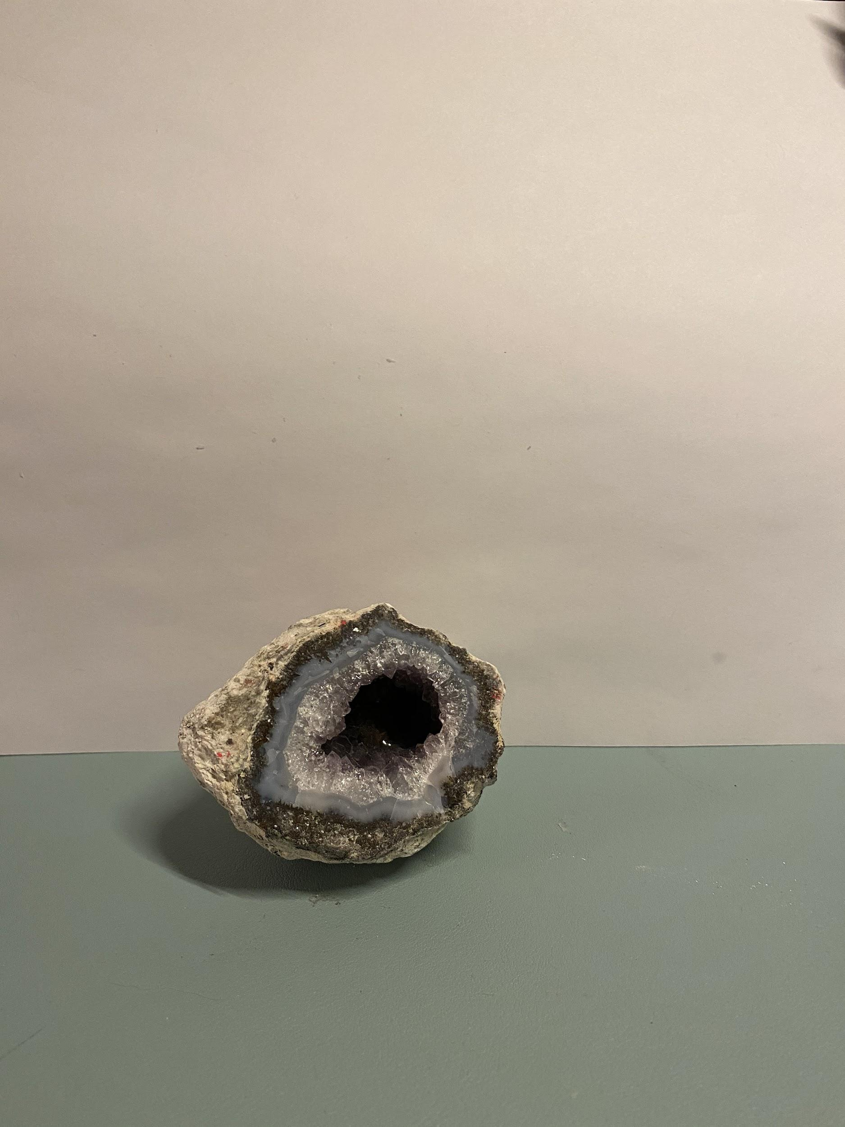
Item Images (1/3)

Slide 3
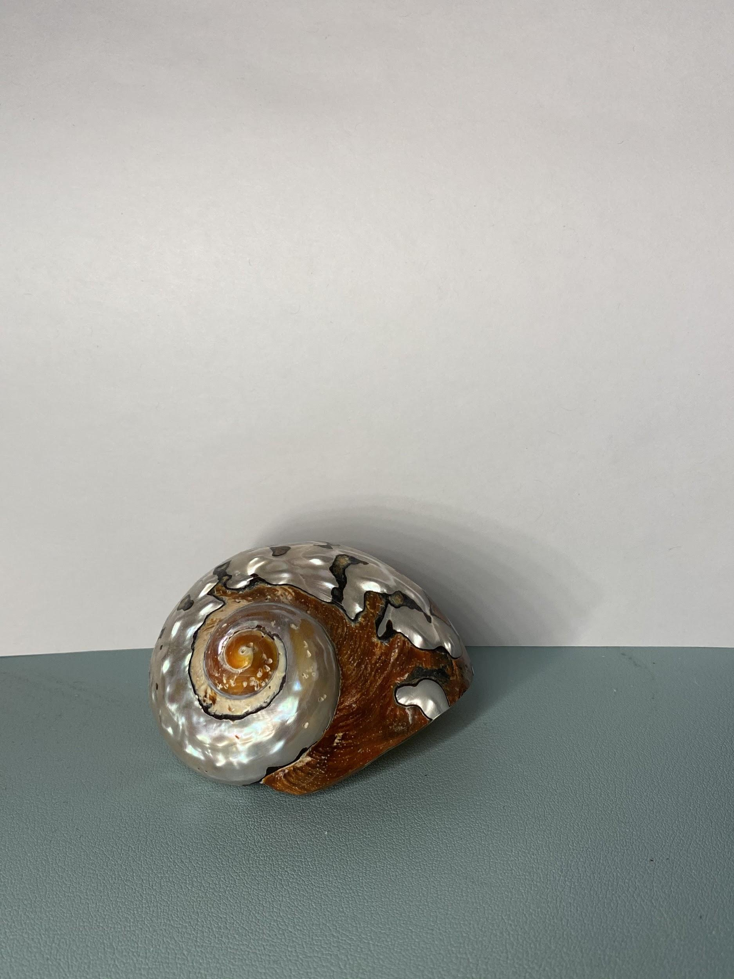
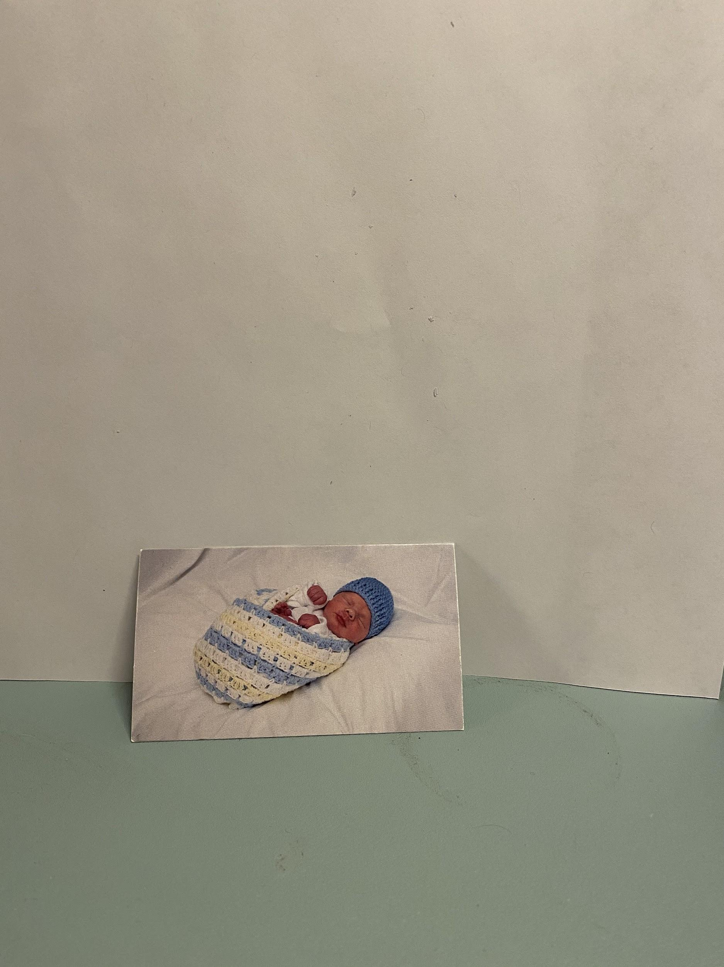
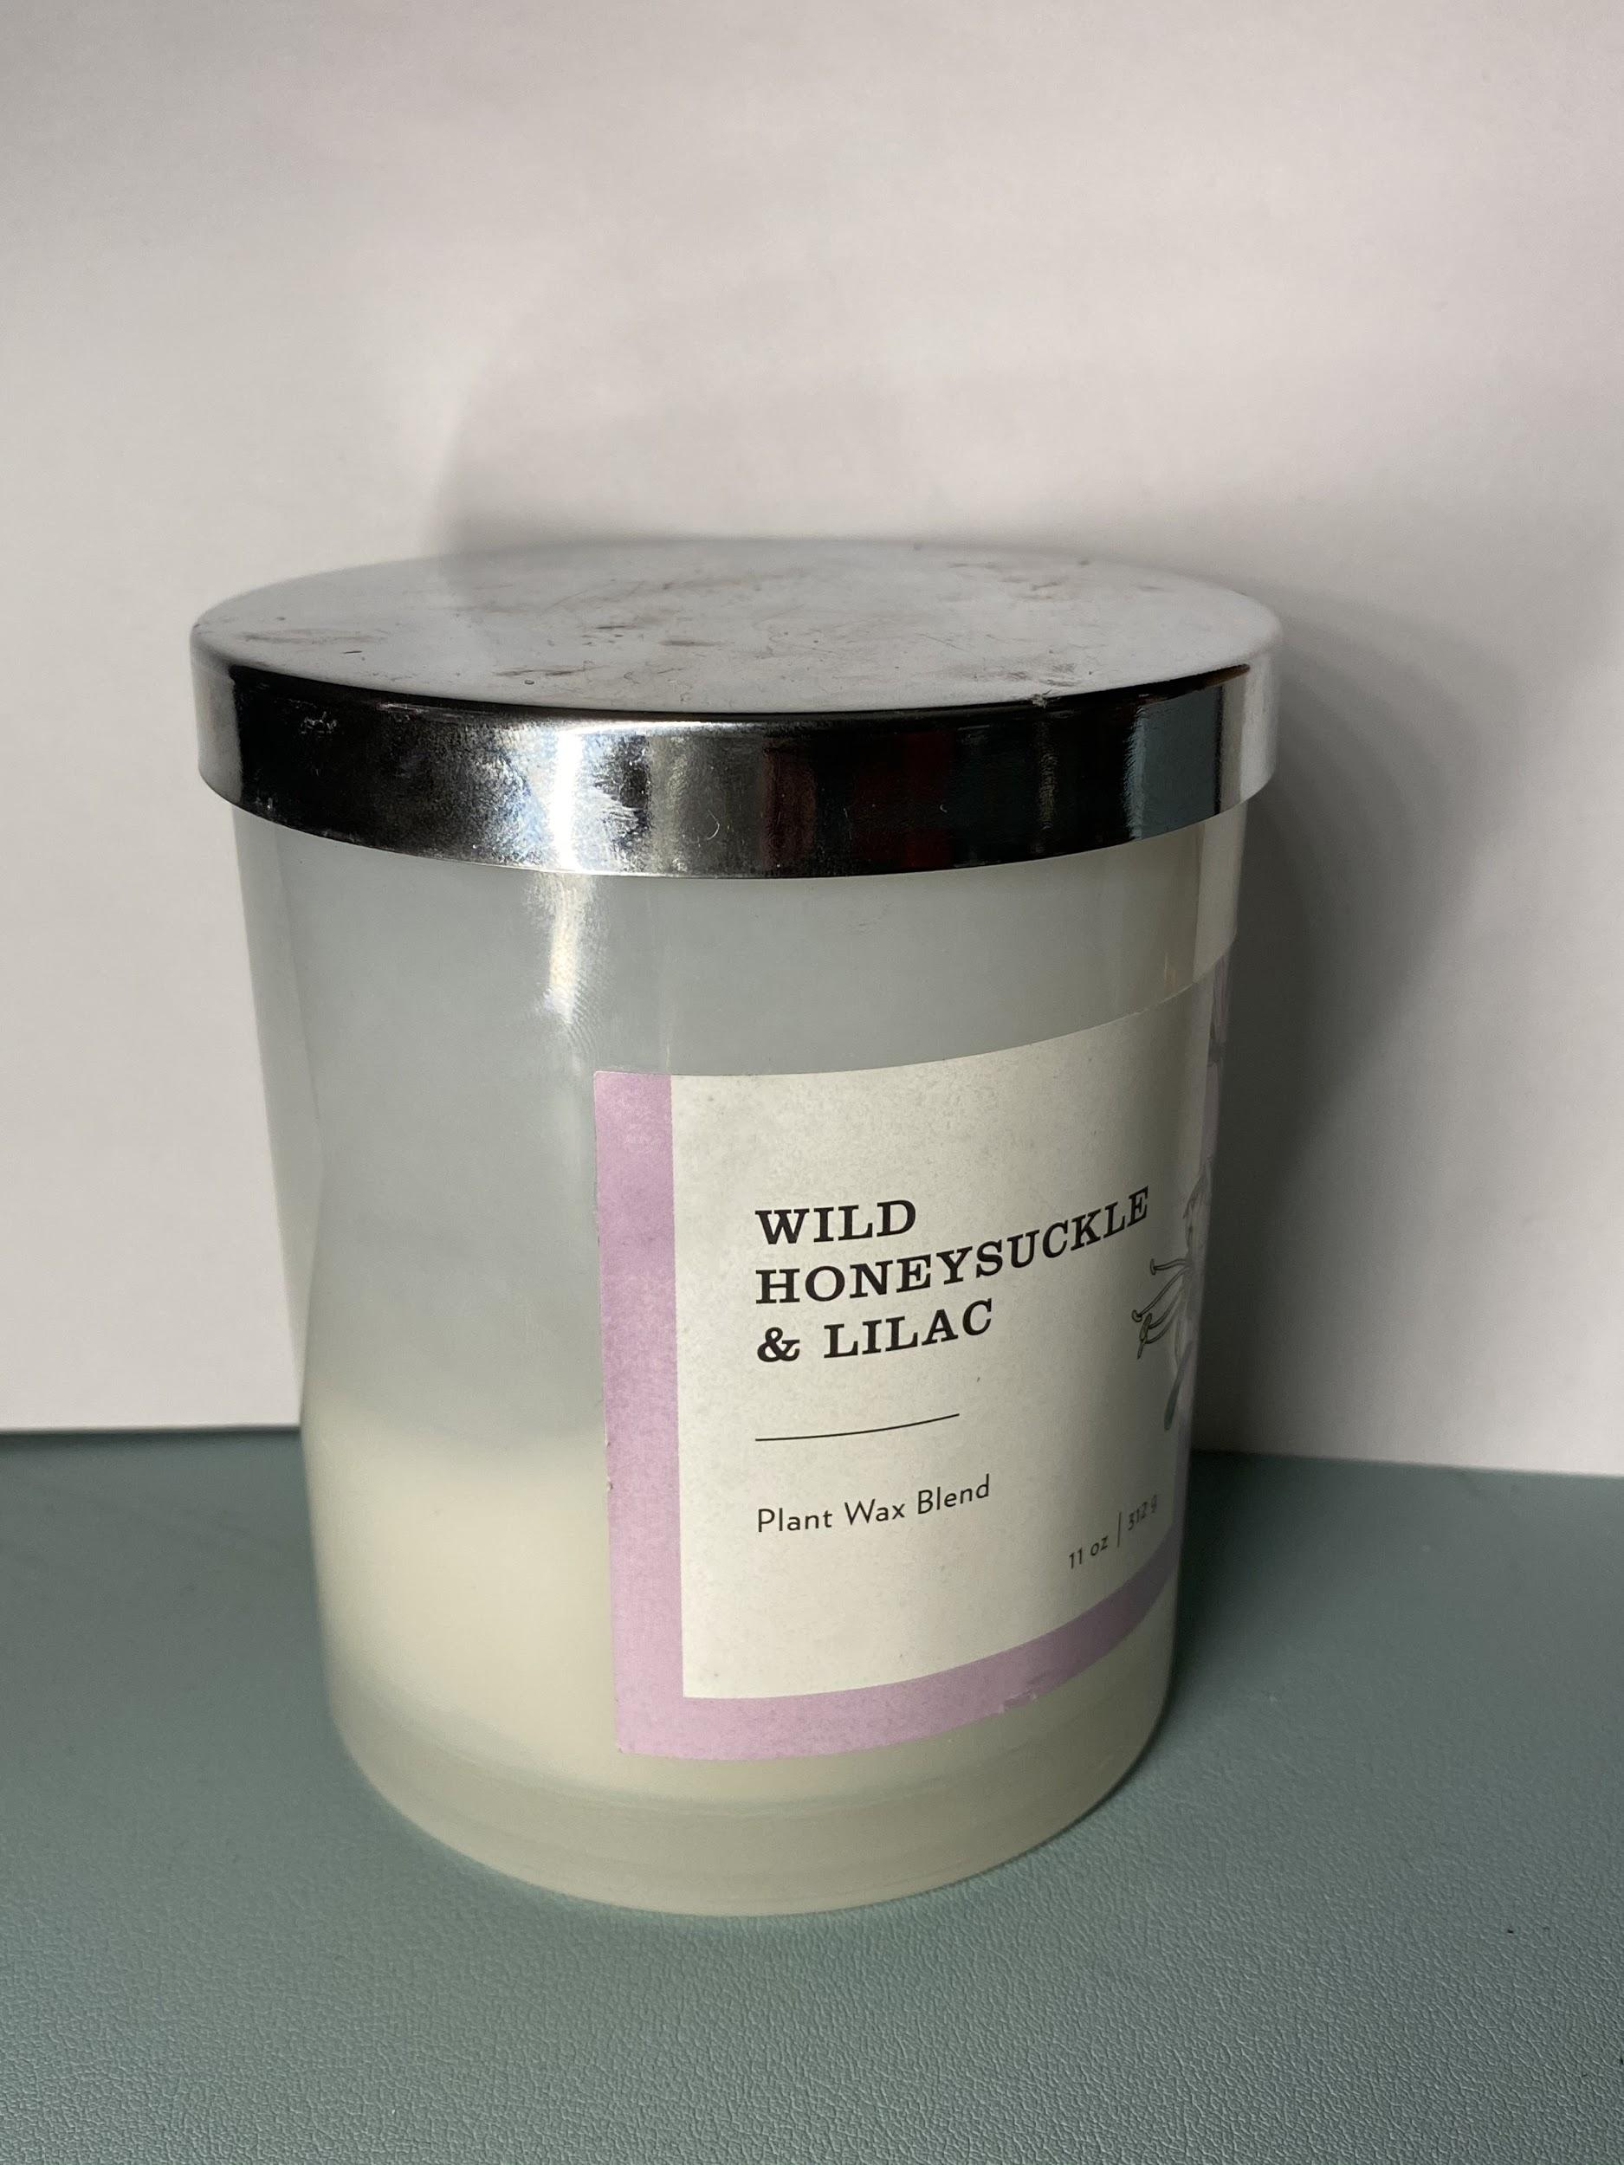
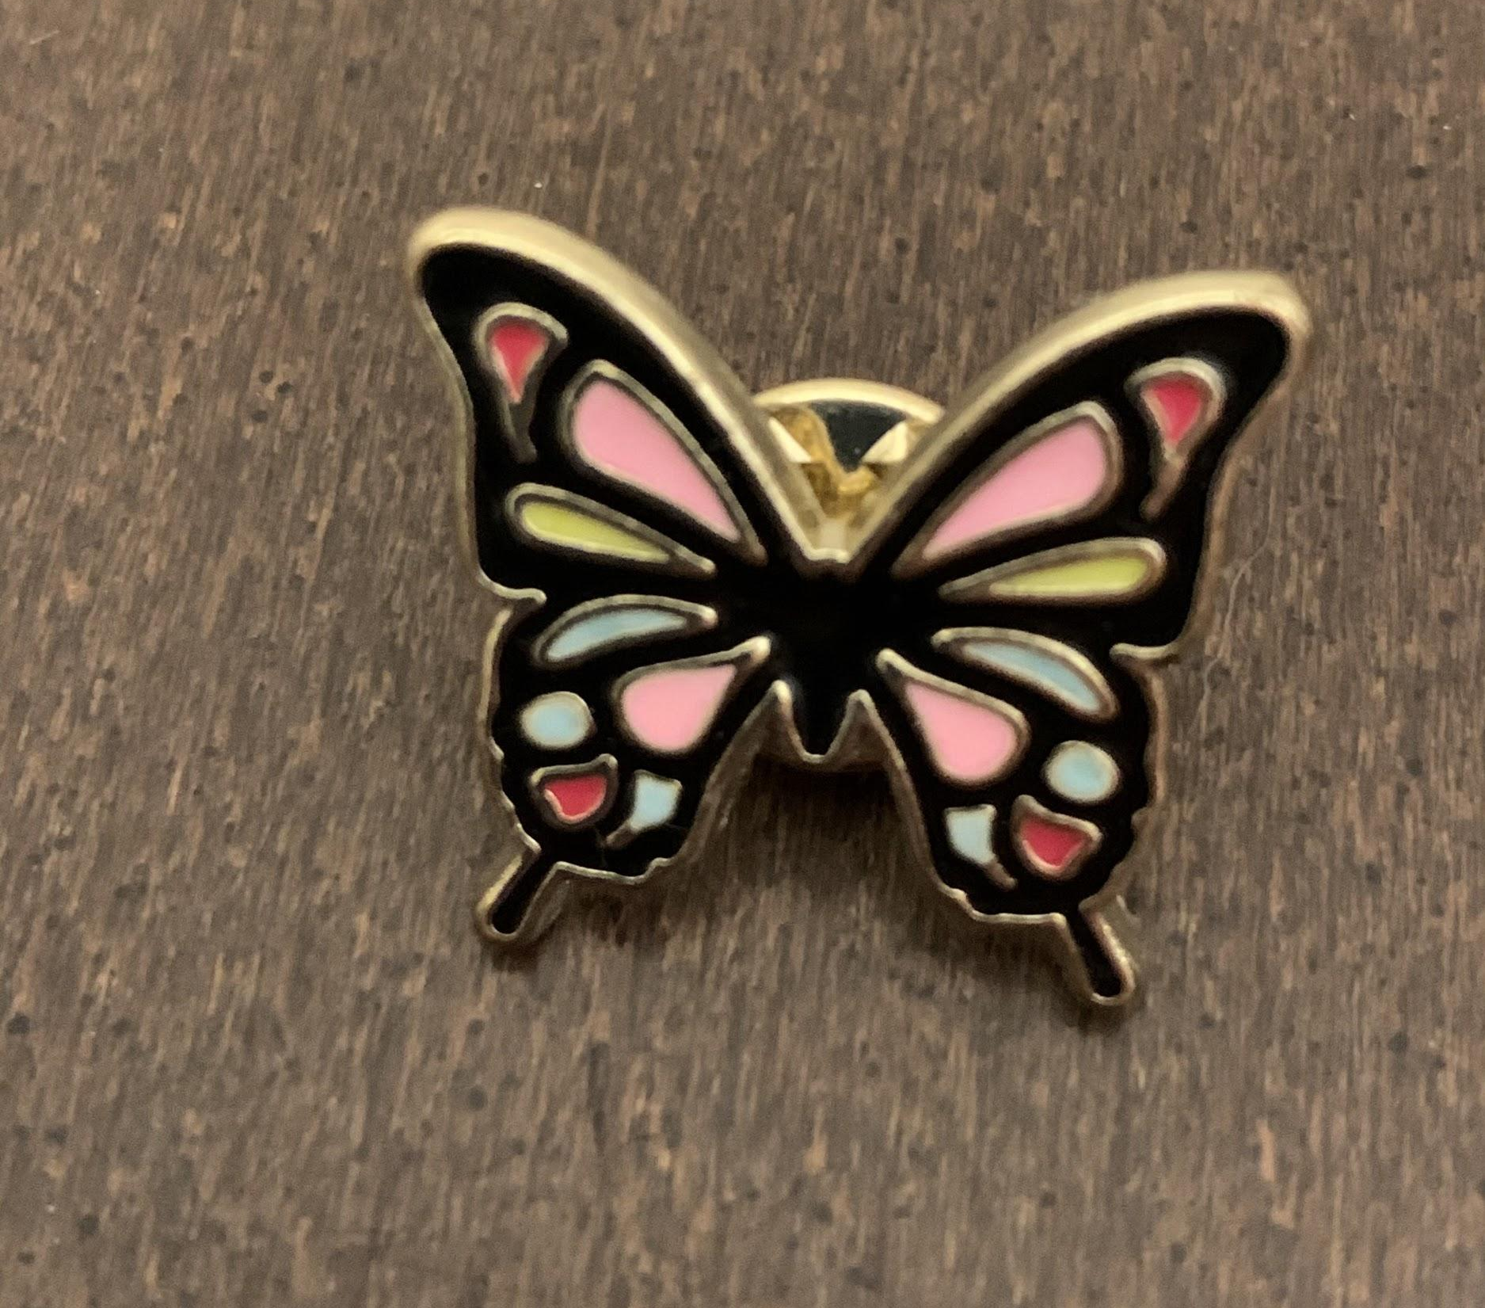
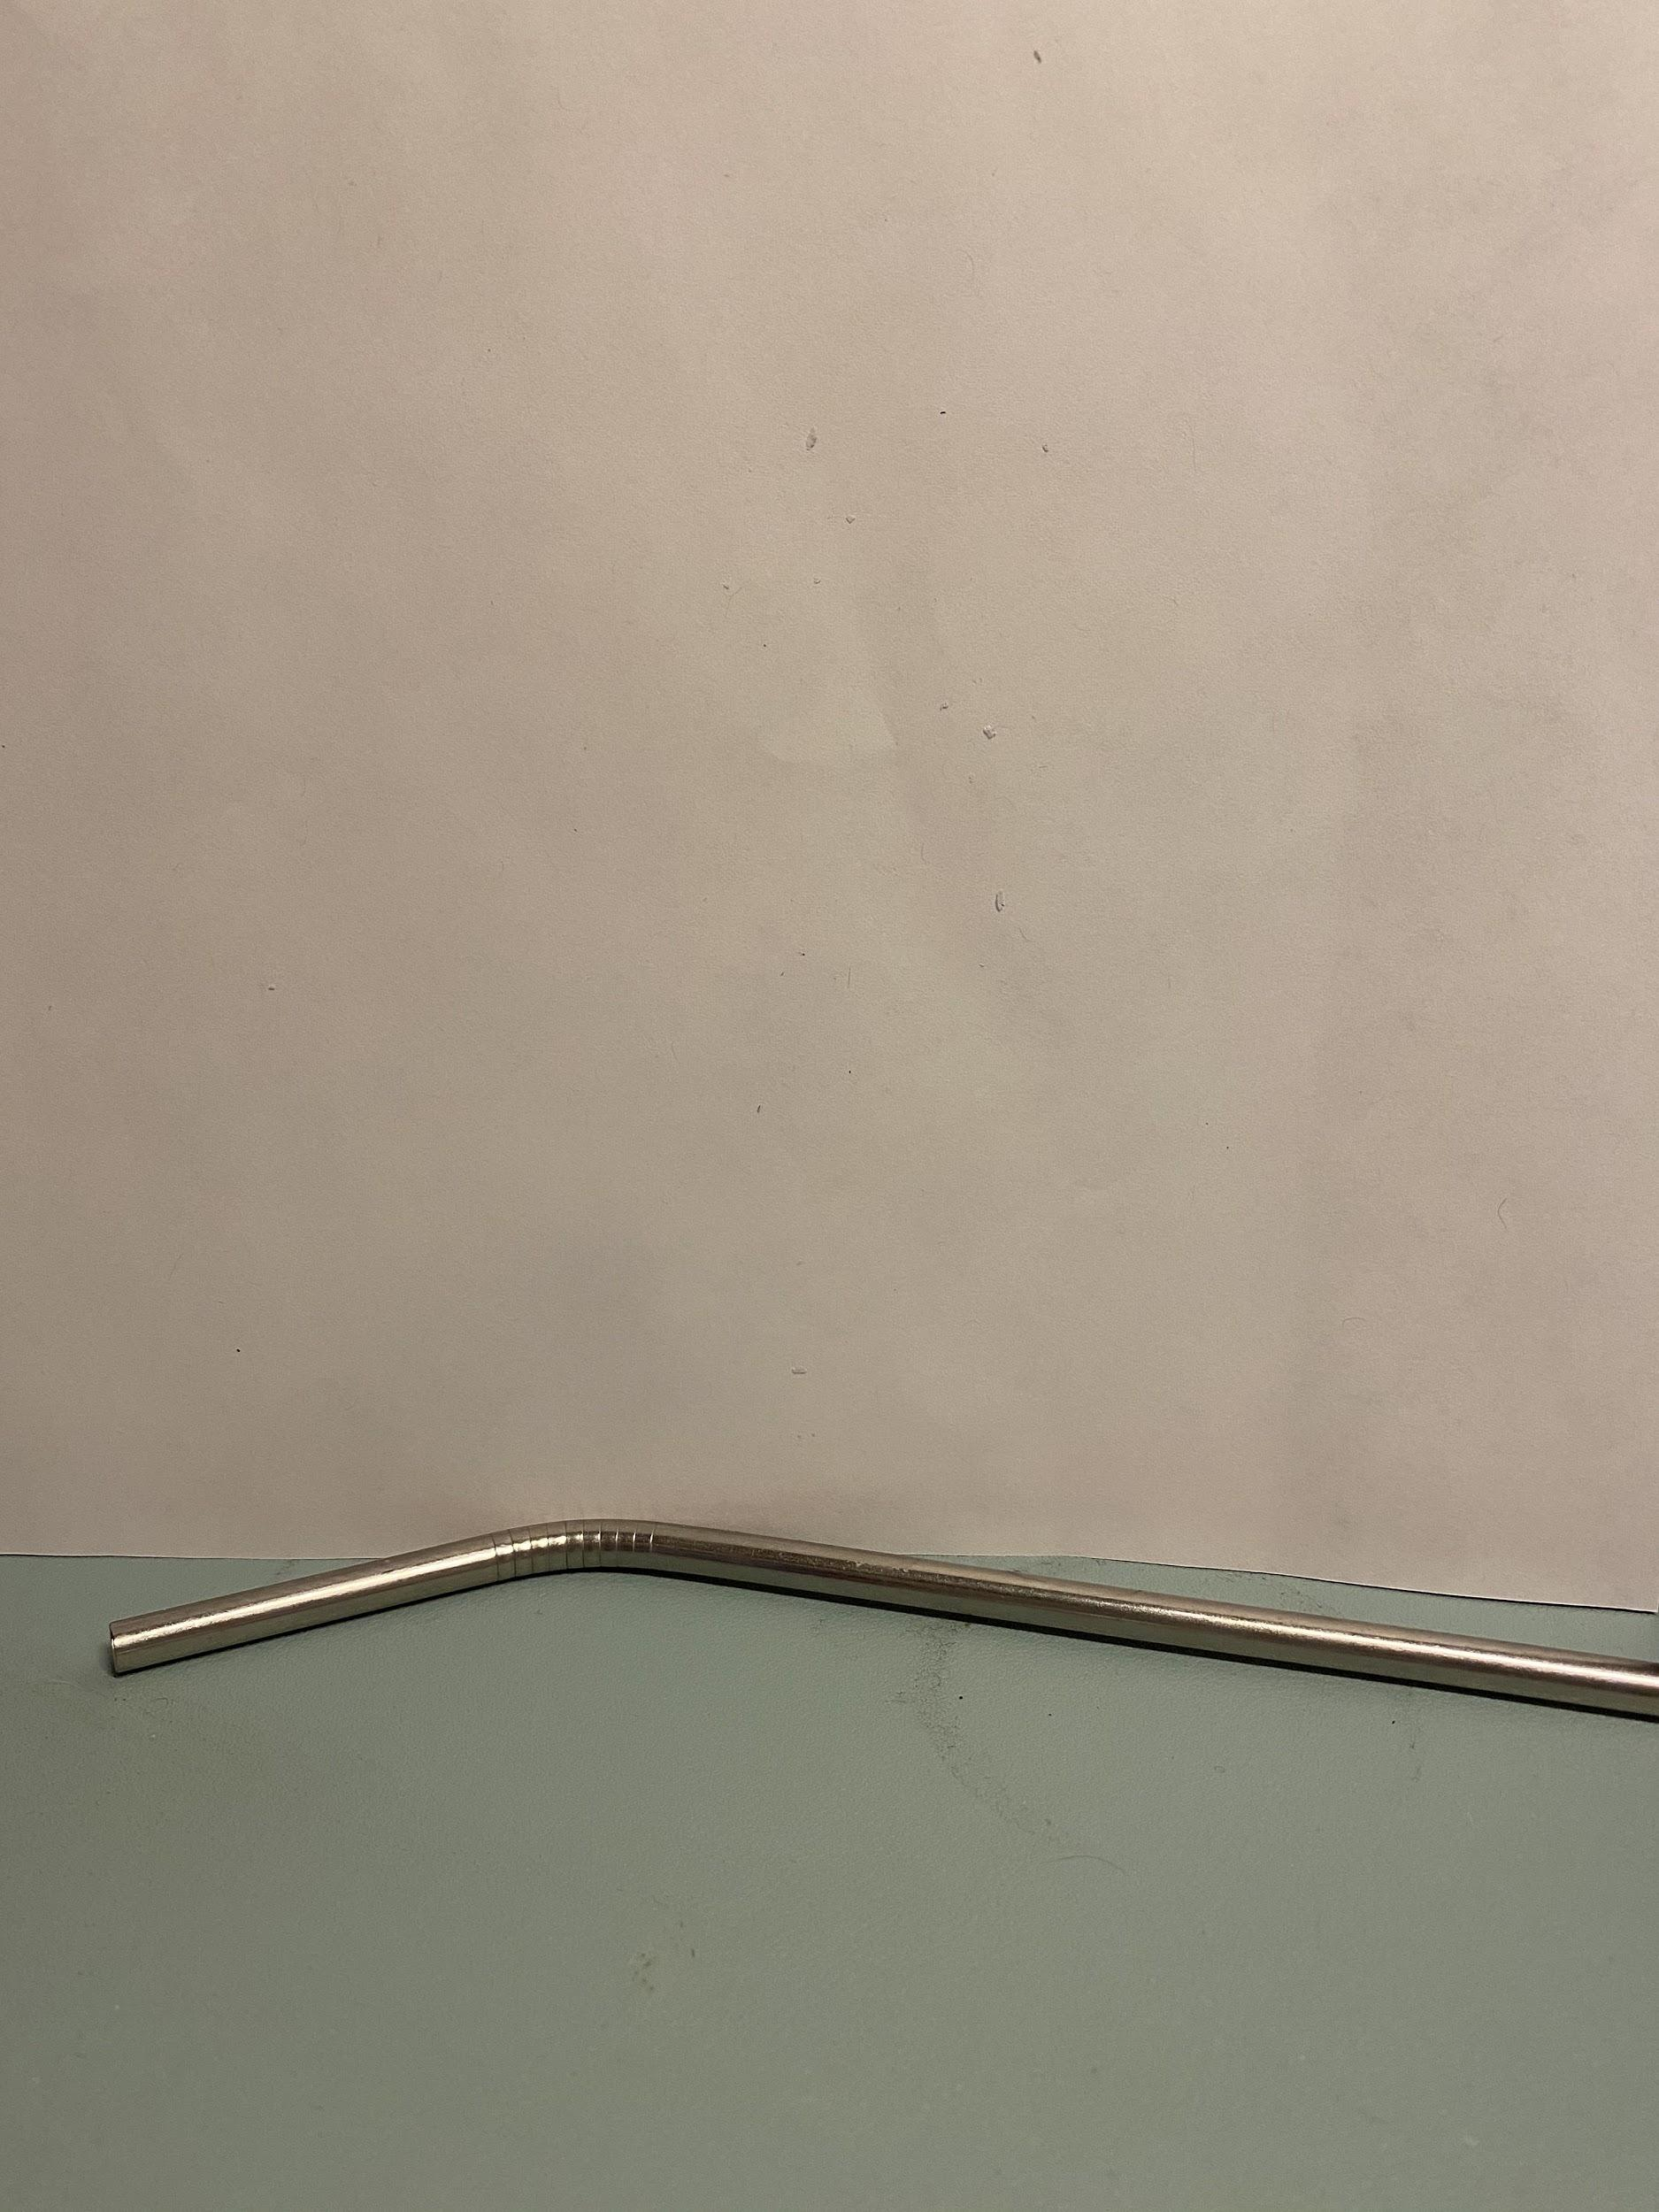
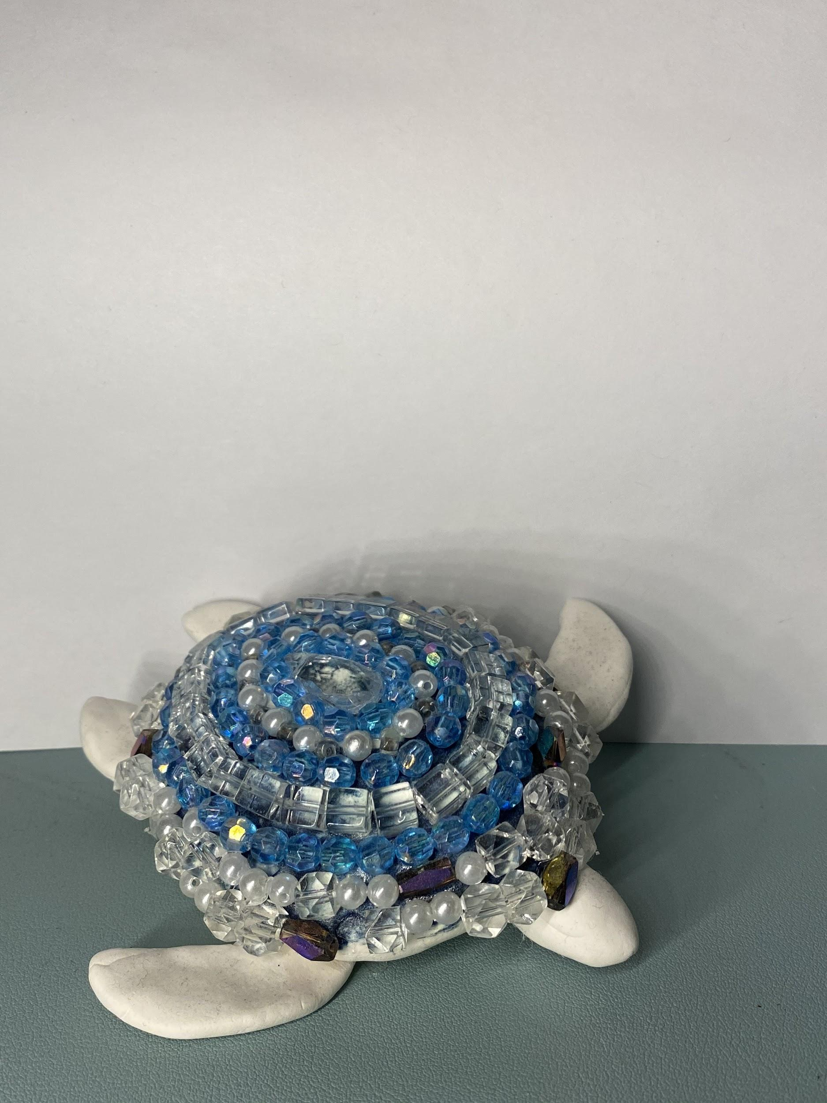
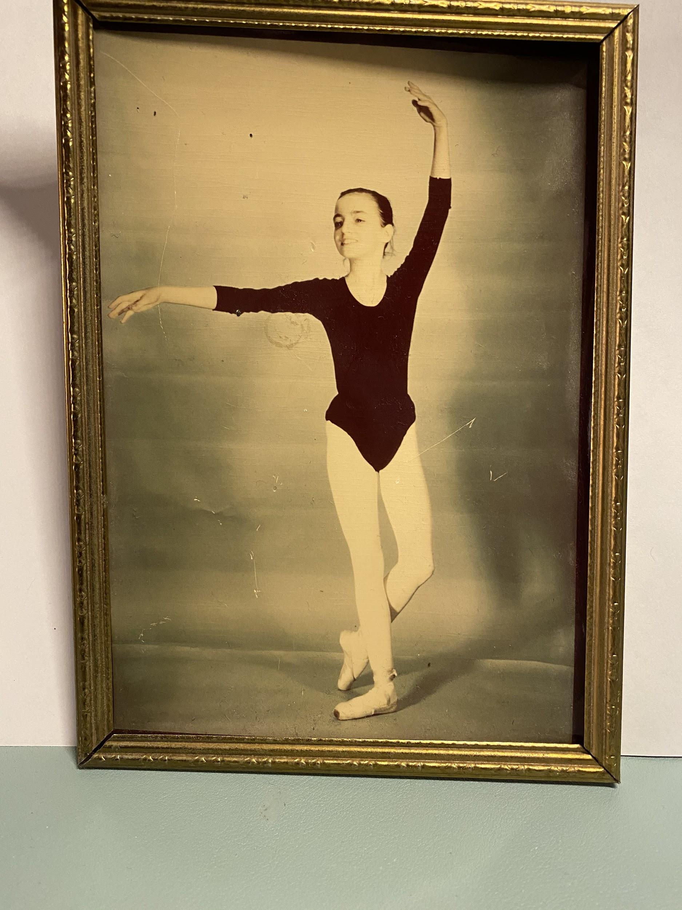
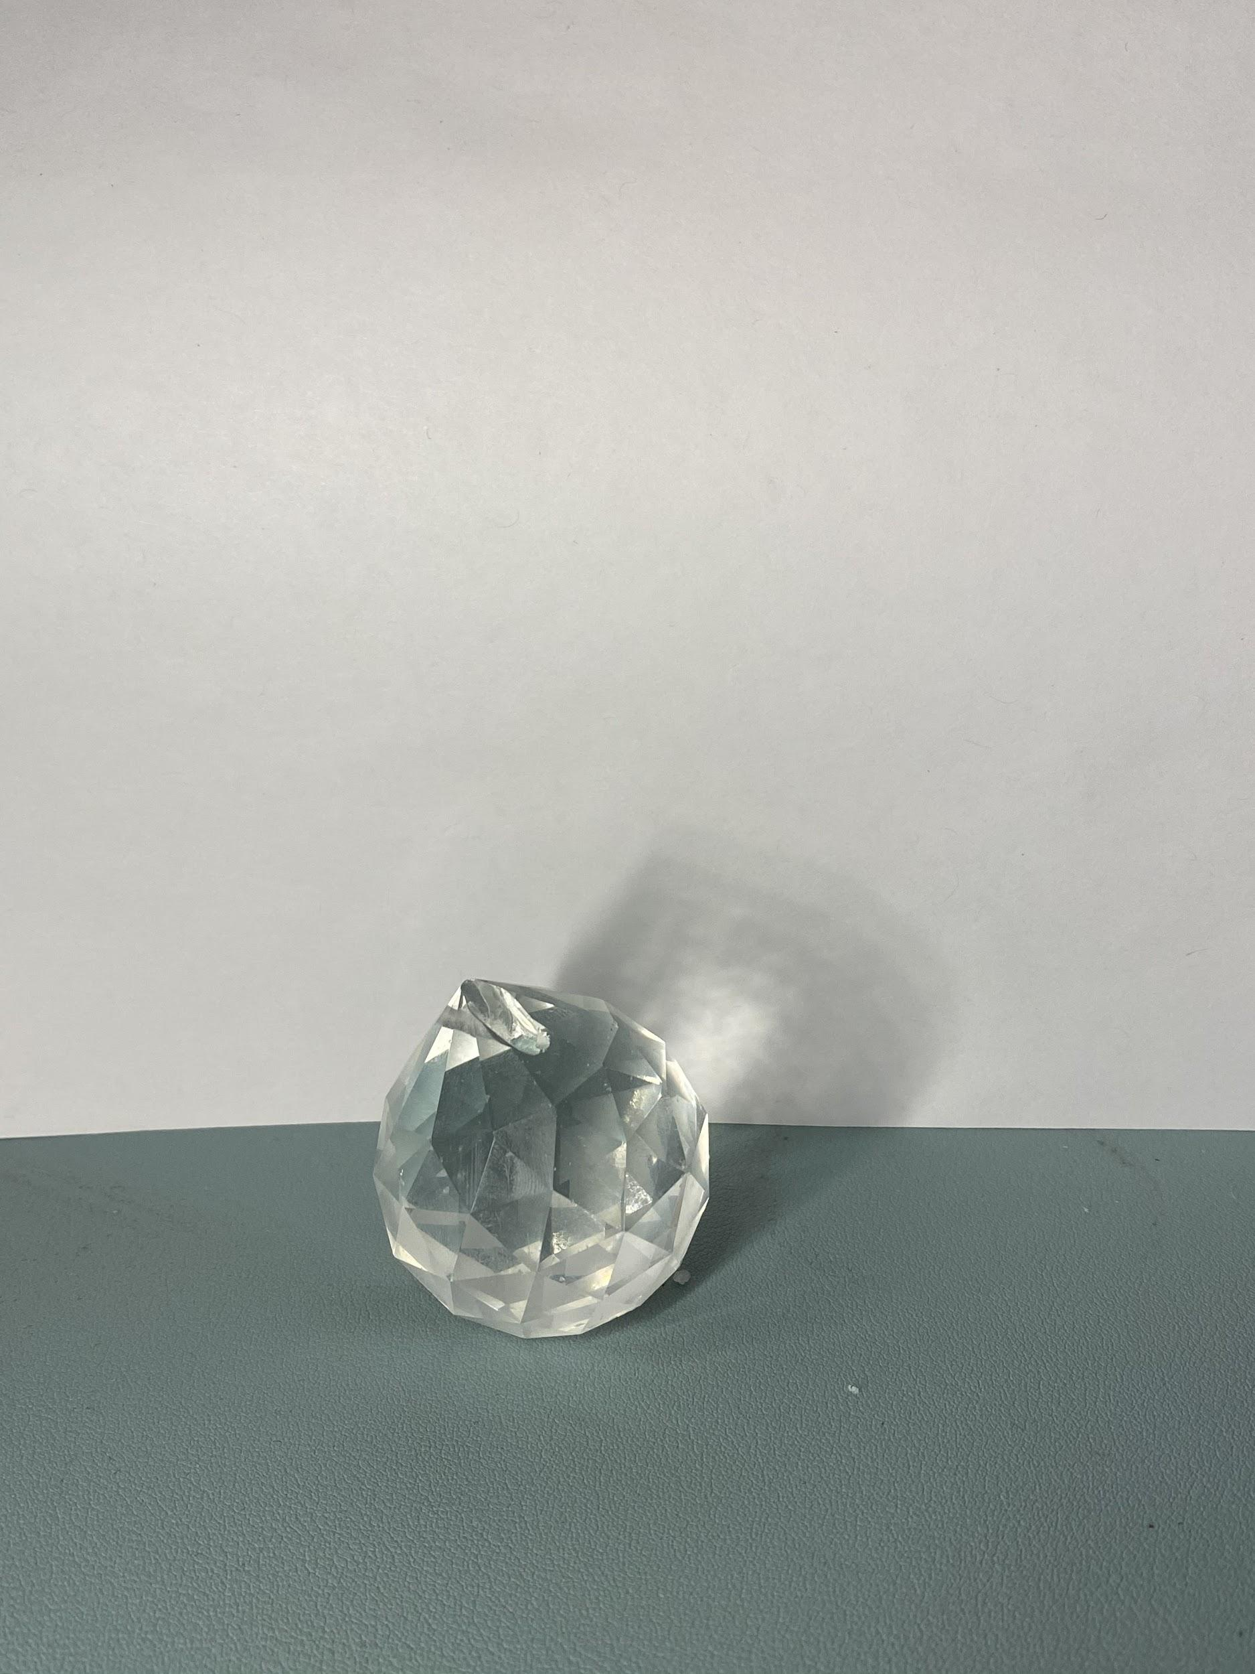
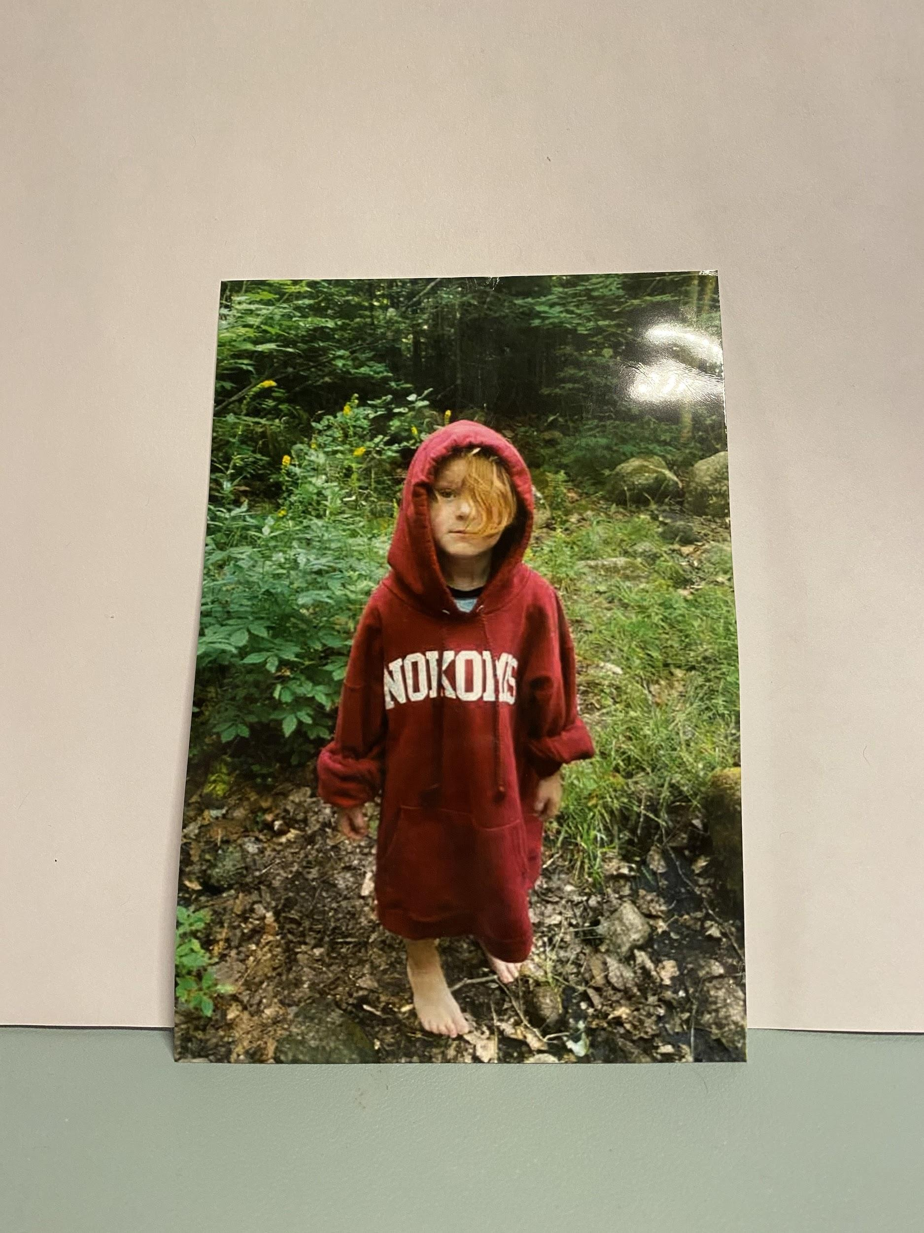
Item Images (2/3)

Slide 4
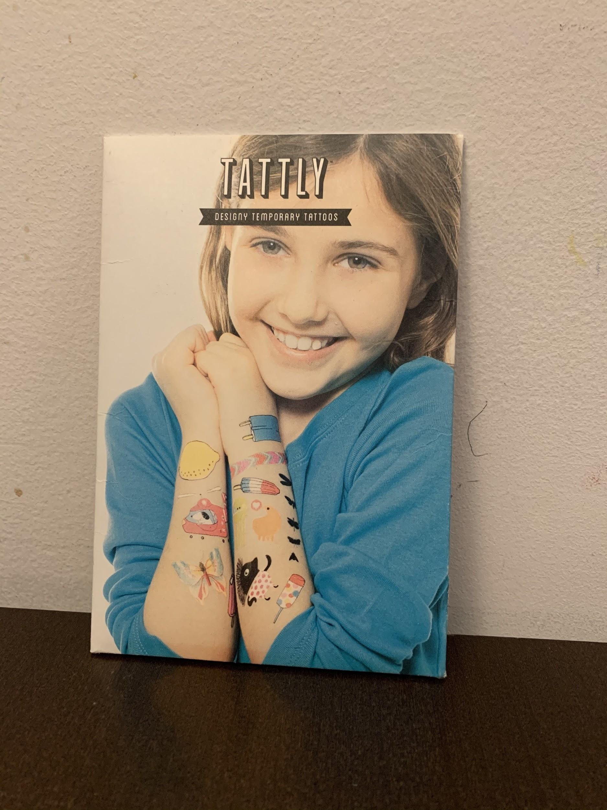
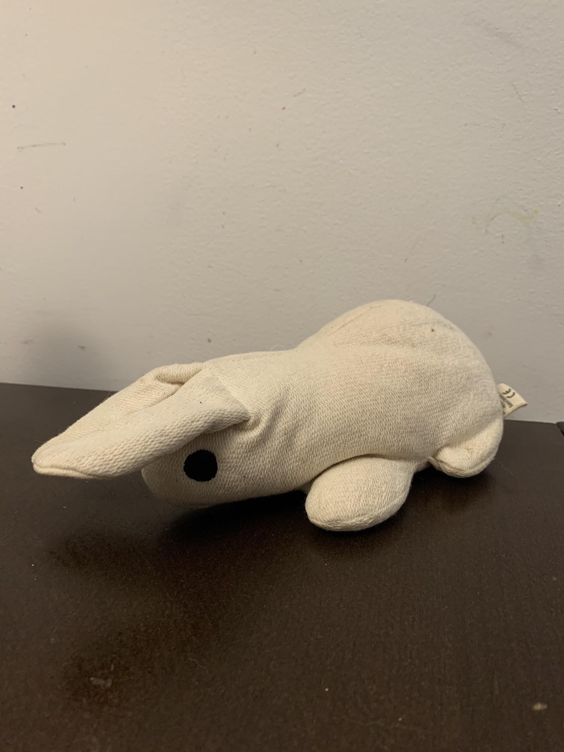
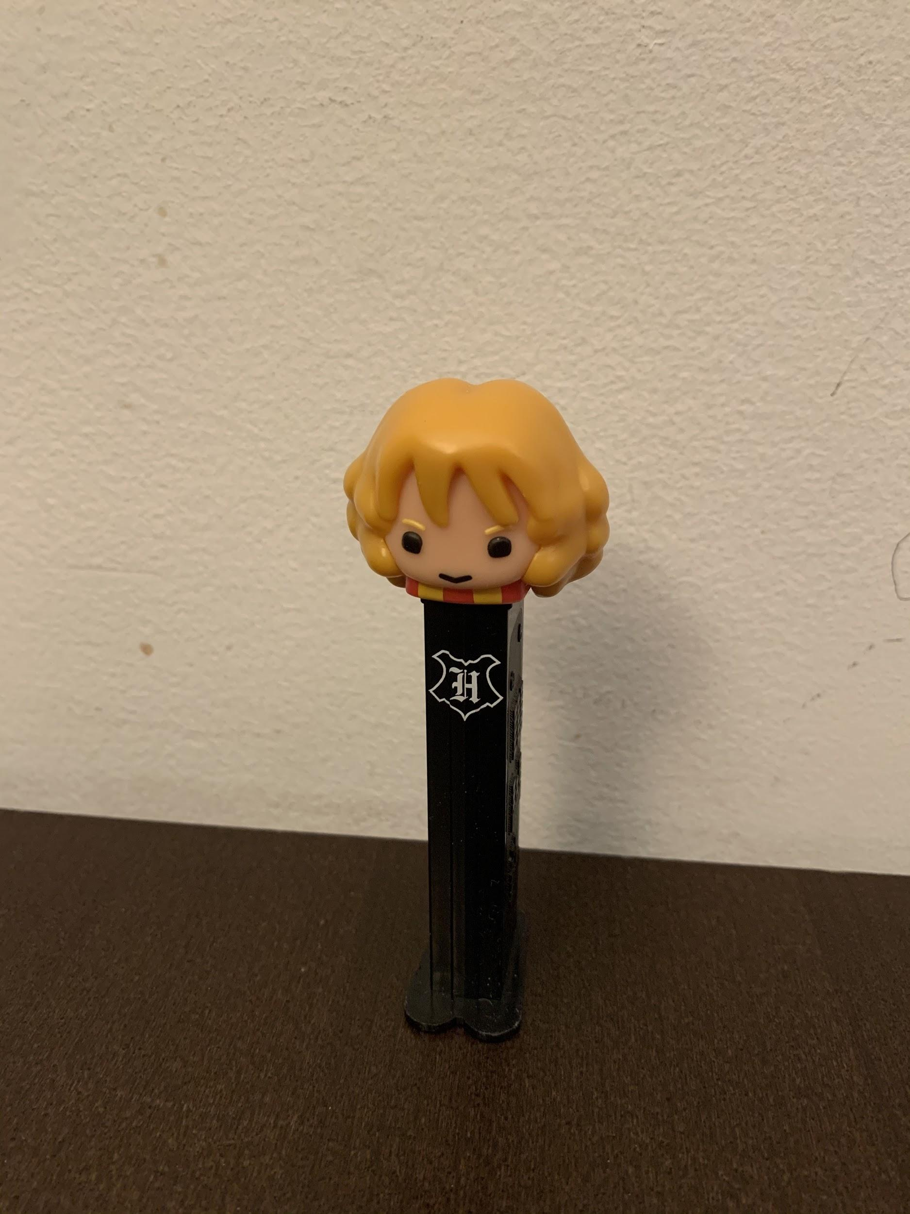
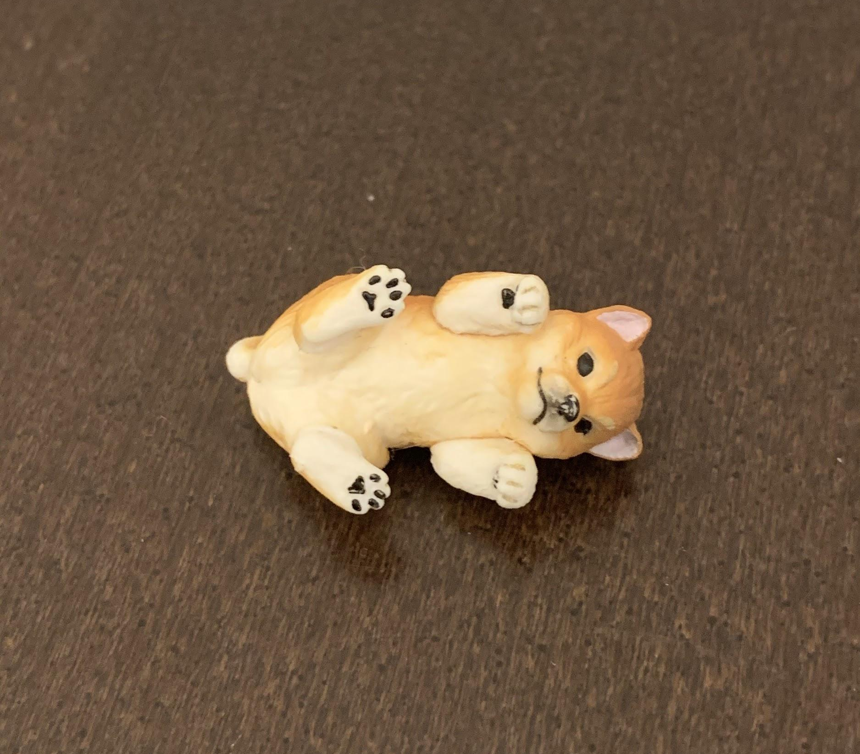
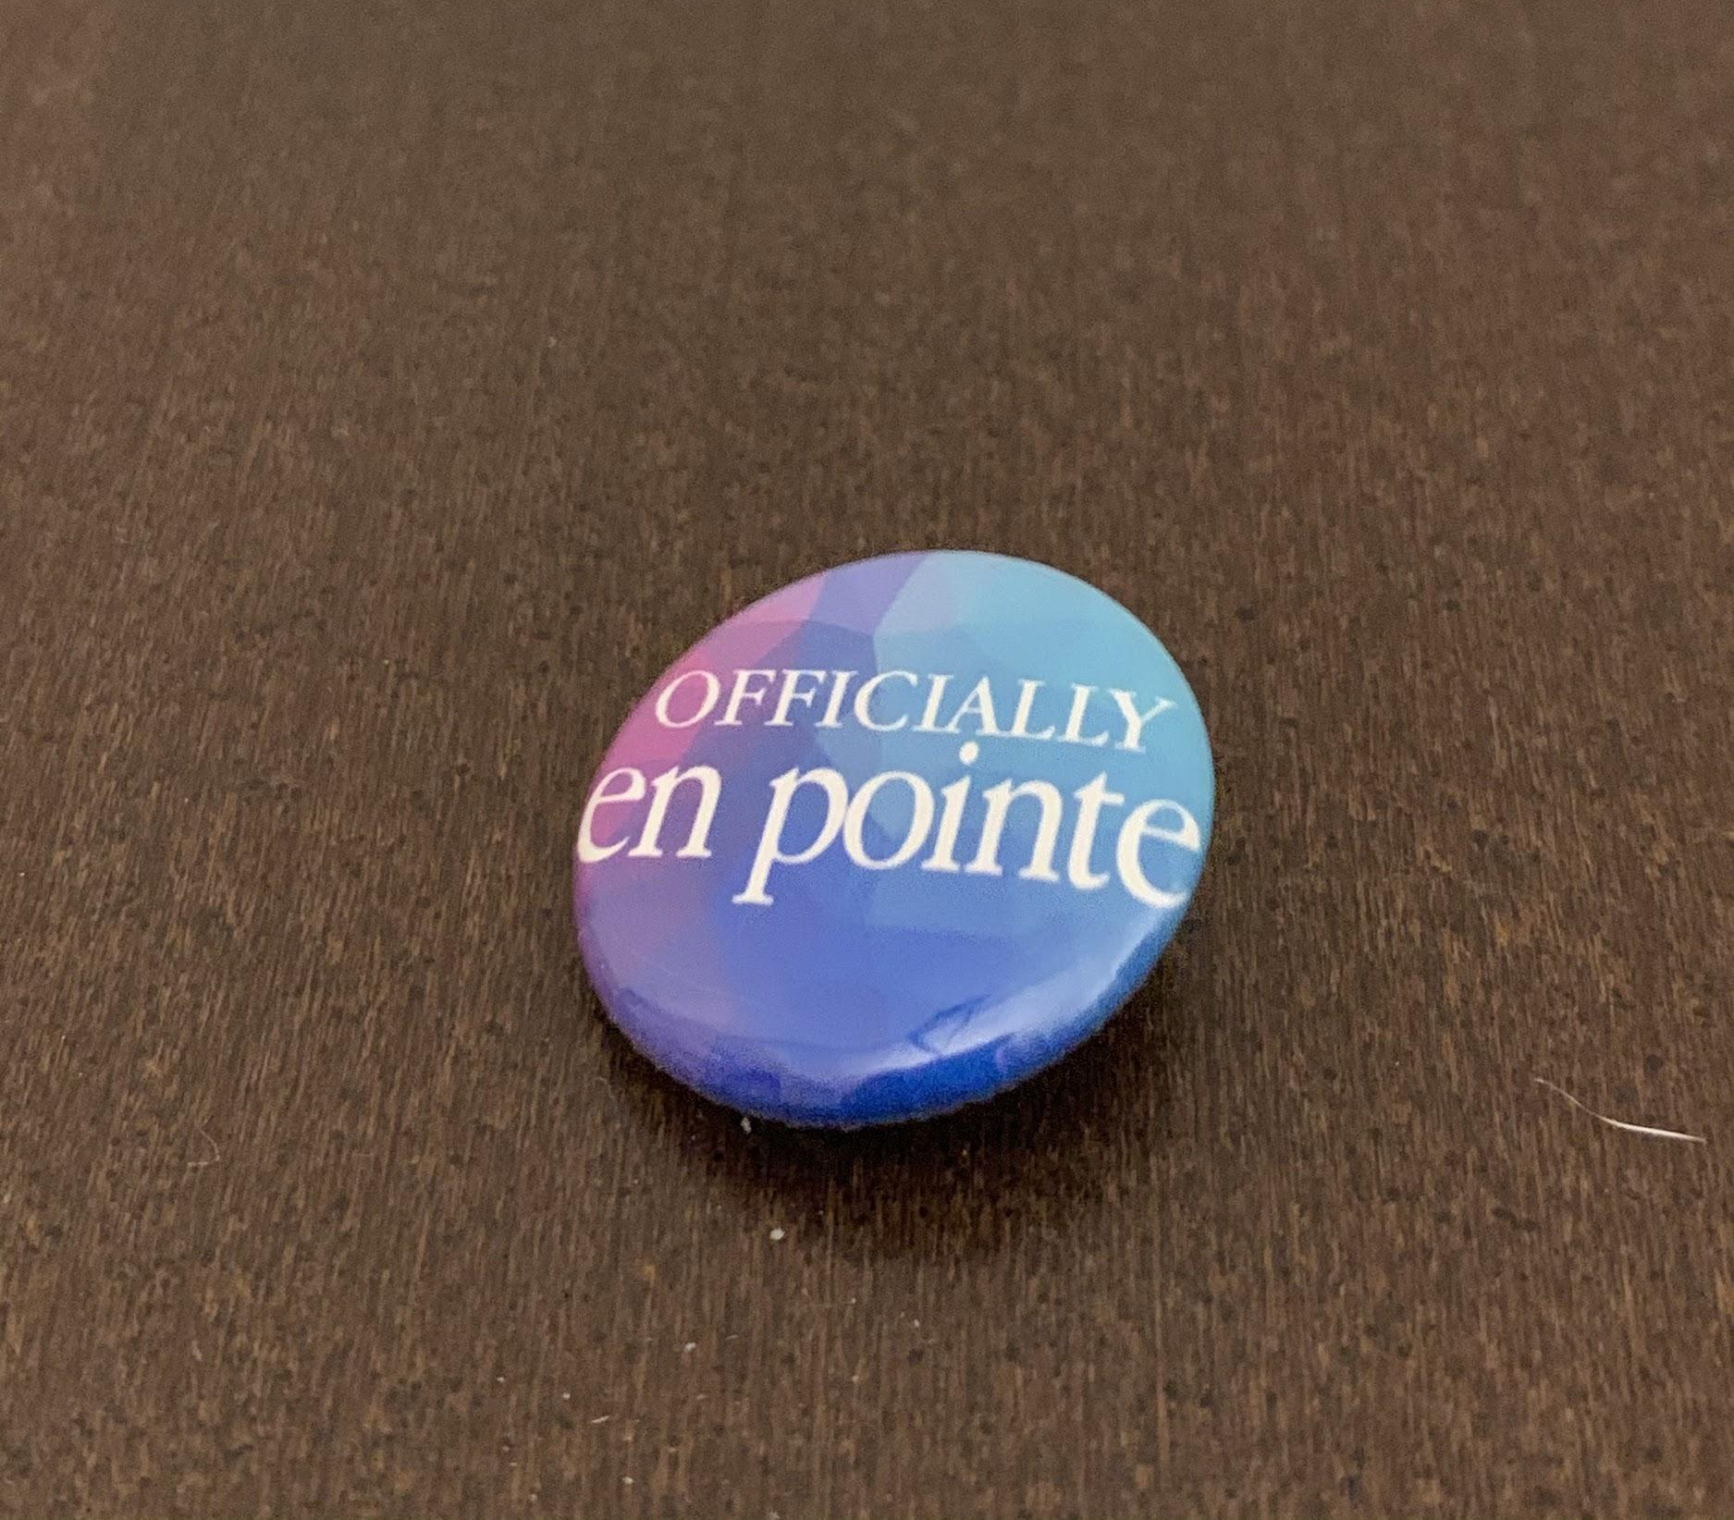
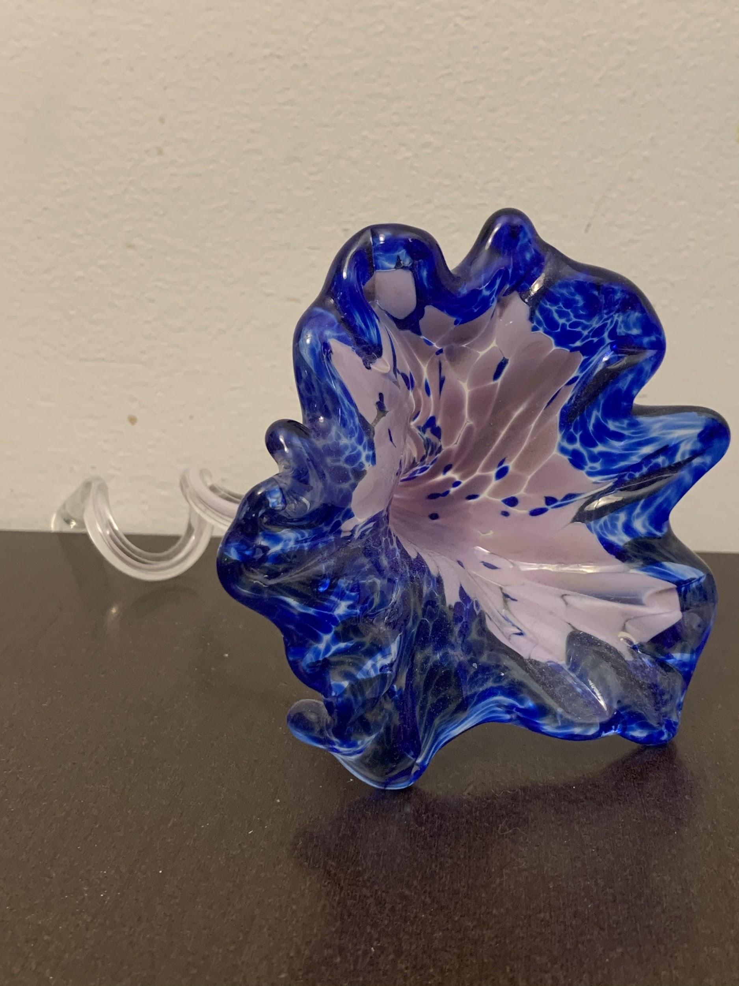
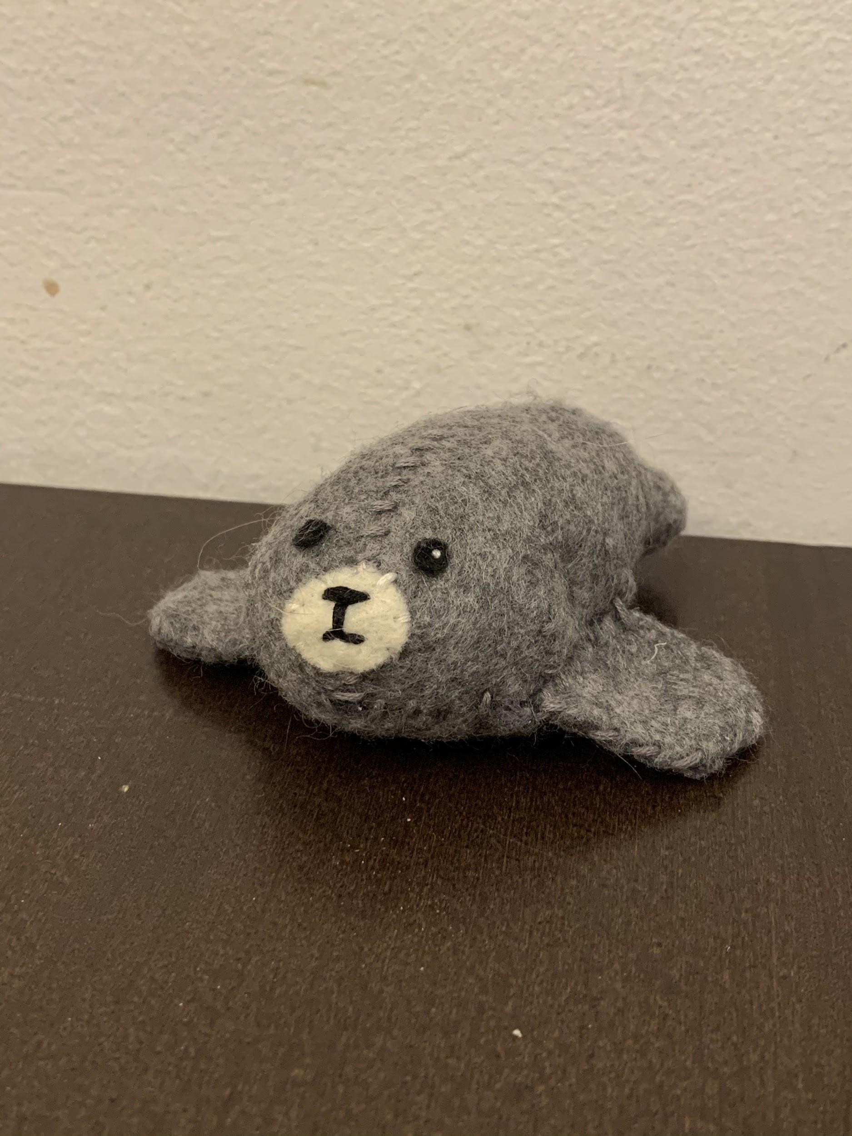
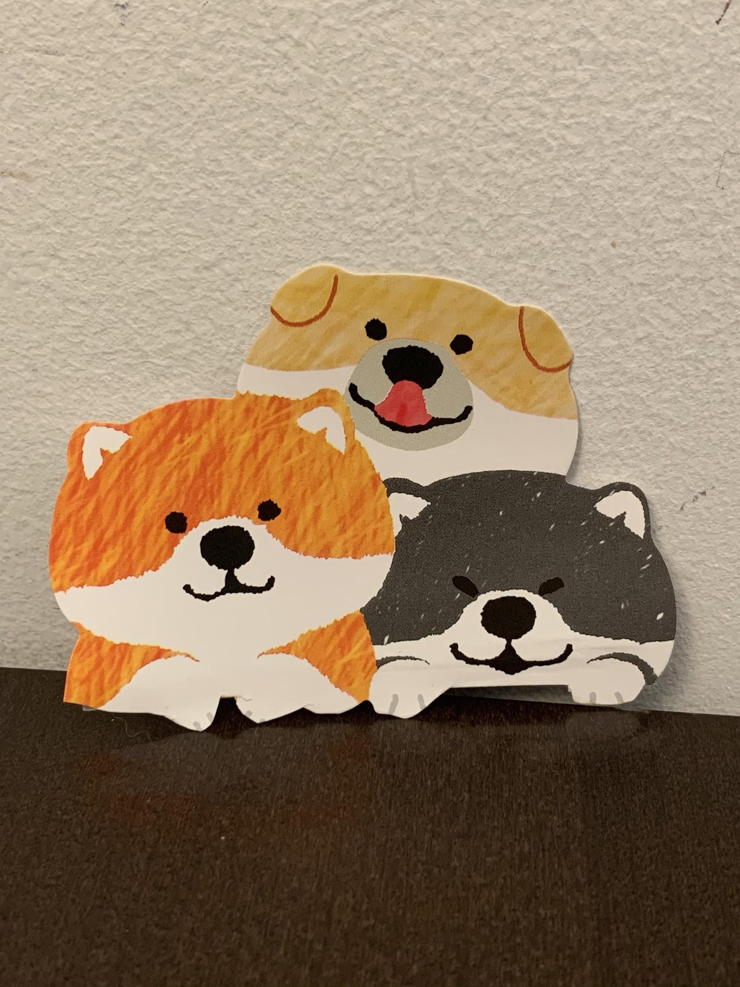
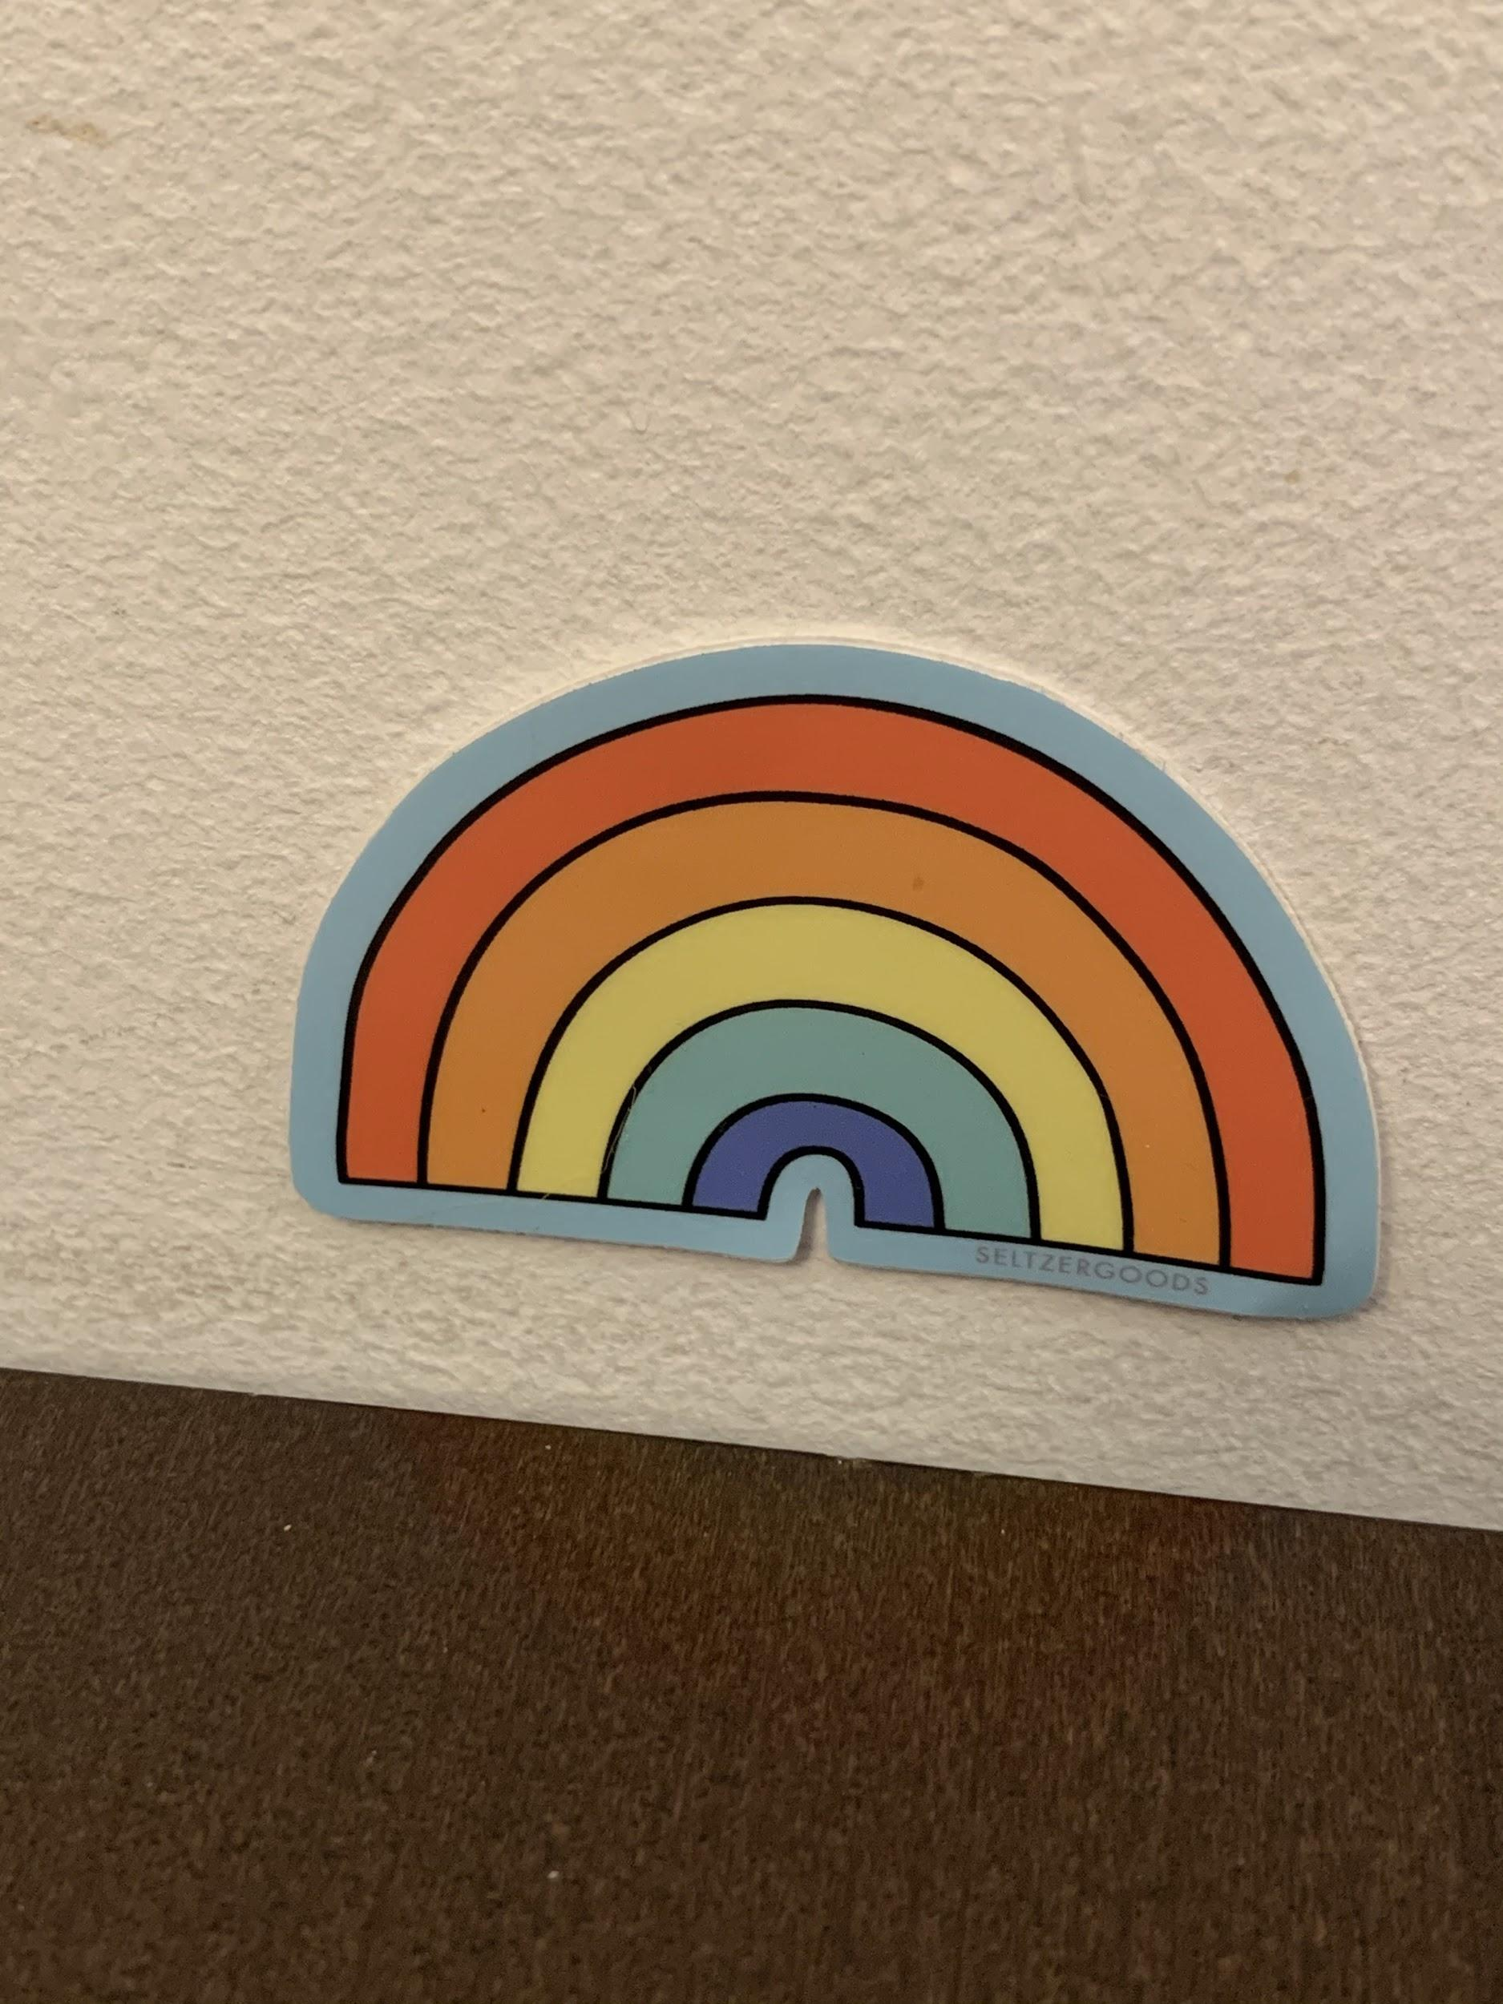
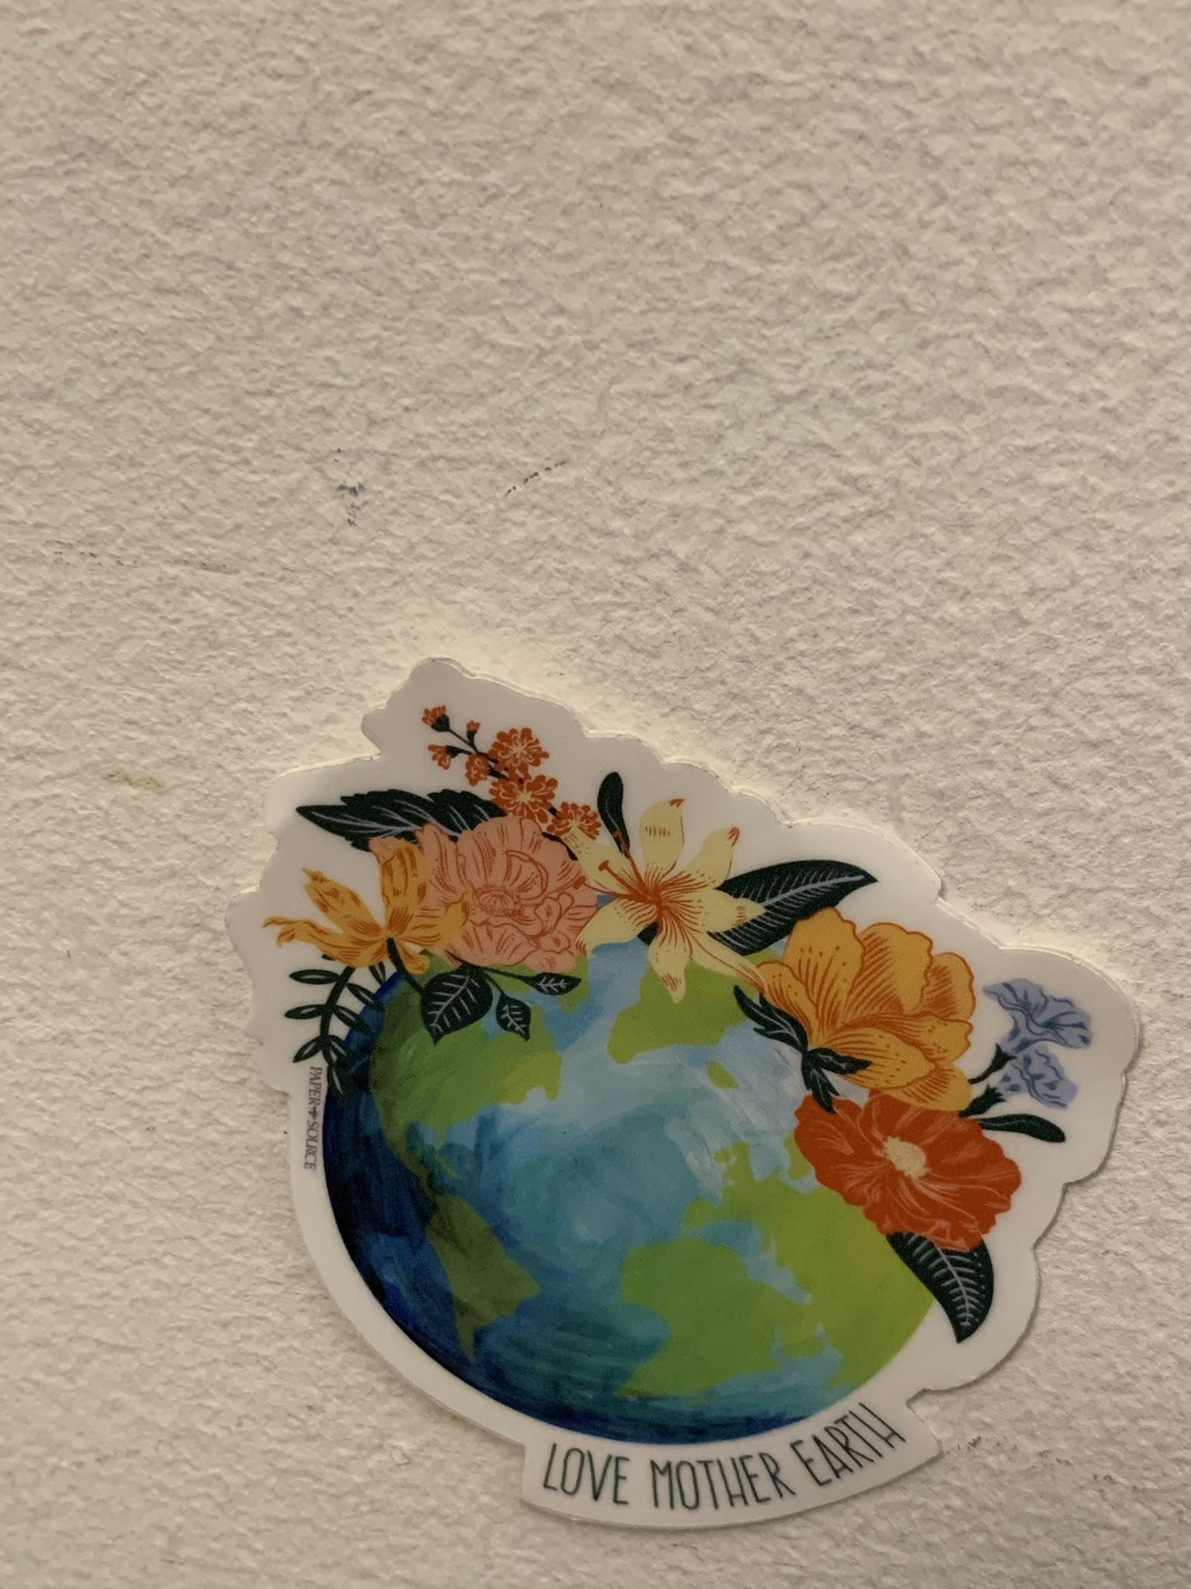
Item Images (3/3)

Slide 5
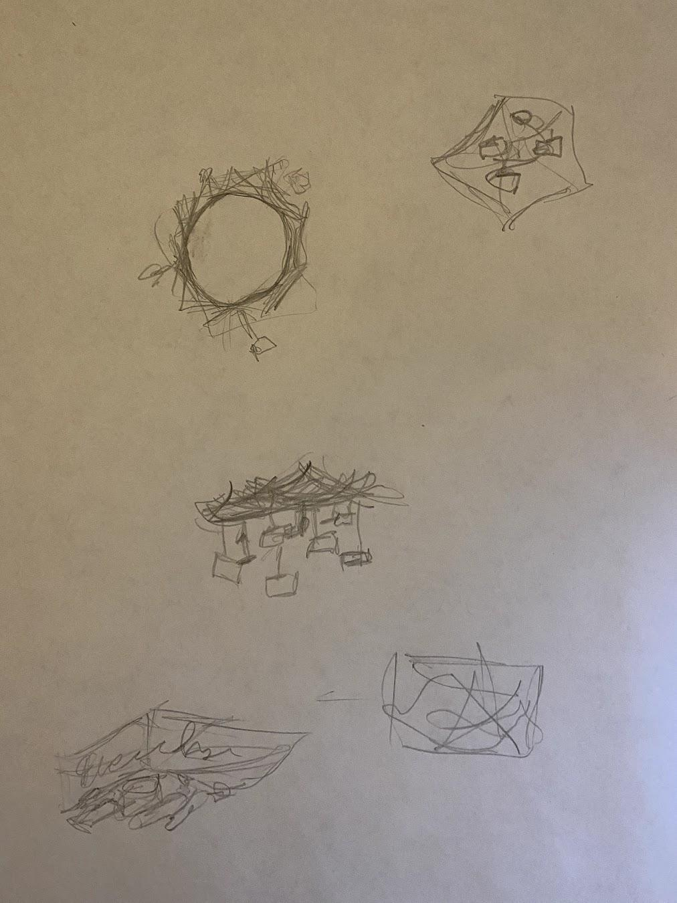
Sketch Concepts
Deciced to go with this one

Slide 6
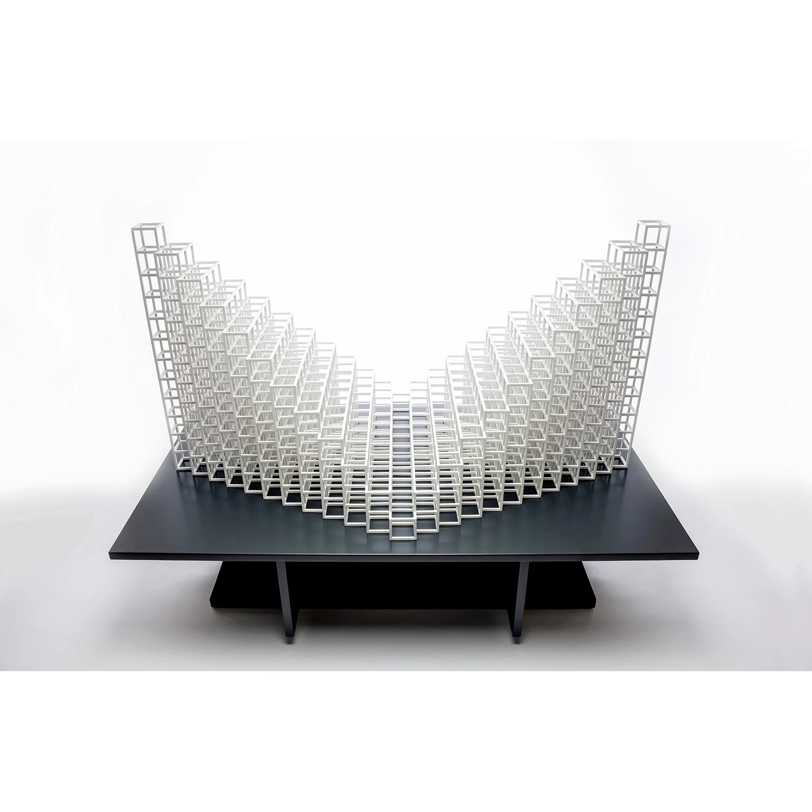
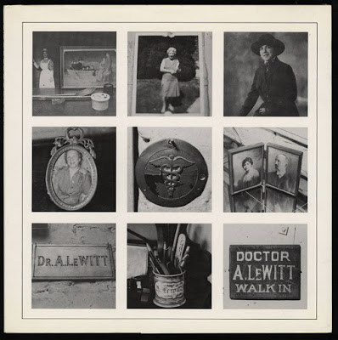
Inspiration
Sol Lewitt
Notes:
Left: http://artistsbooksandmultiples.blogspot.com/2015/08/sol-lewitt-autobiography.html
Right: https://www.mutualart.com/Artwork/Cube-Structure-Based-on-Five-Modules--3-/18B3FB2ECA8F21F4

Slide 7
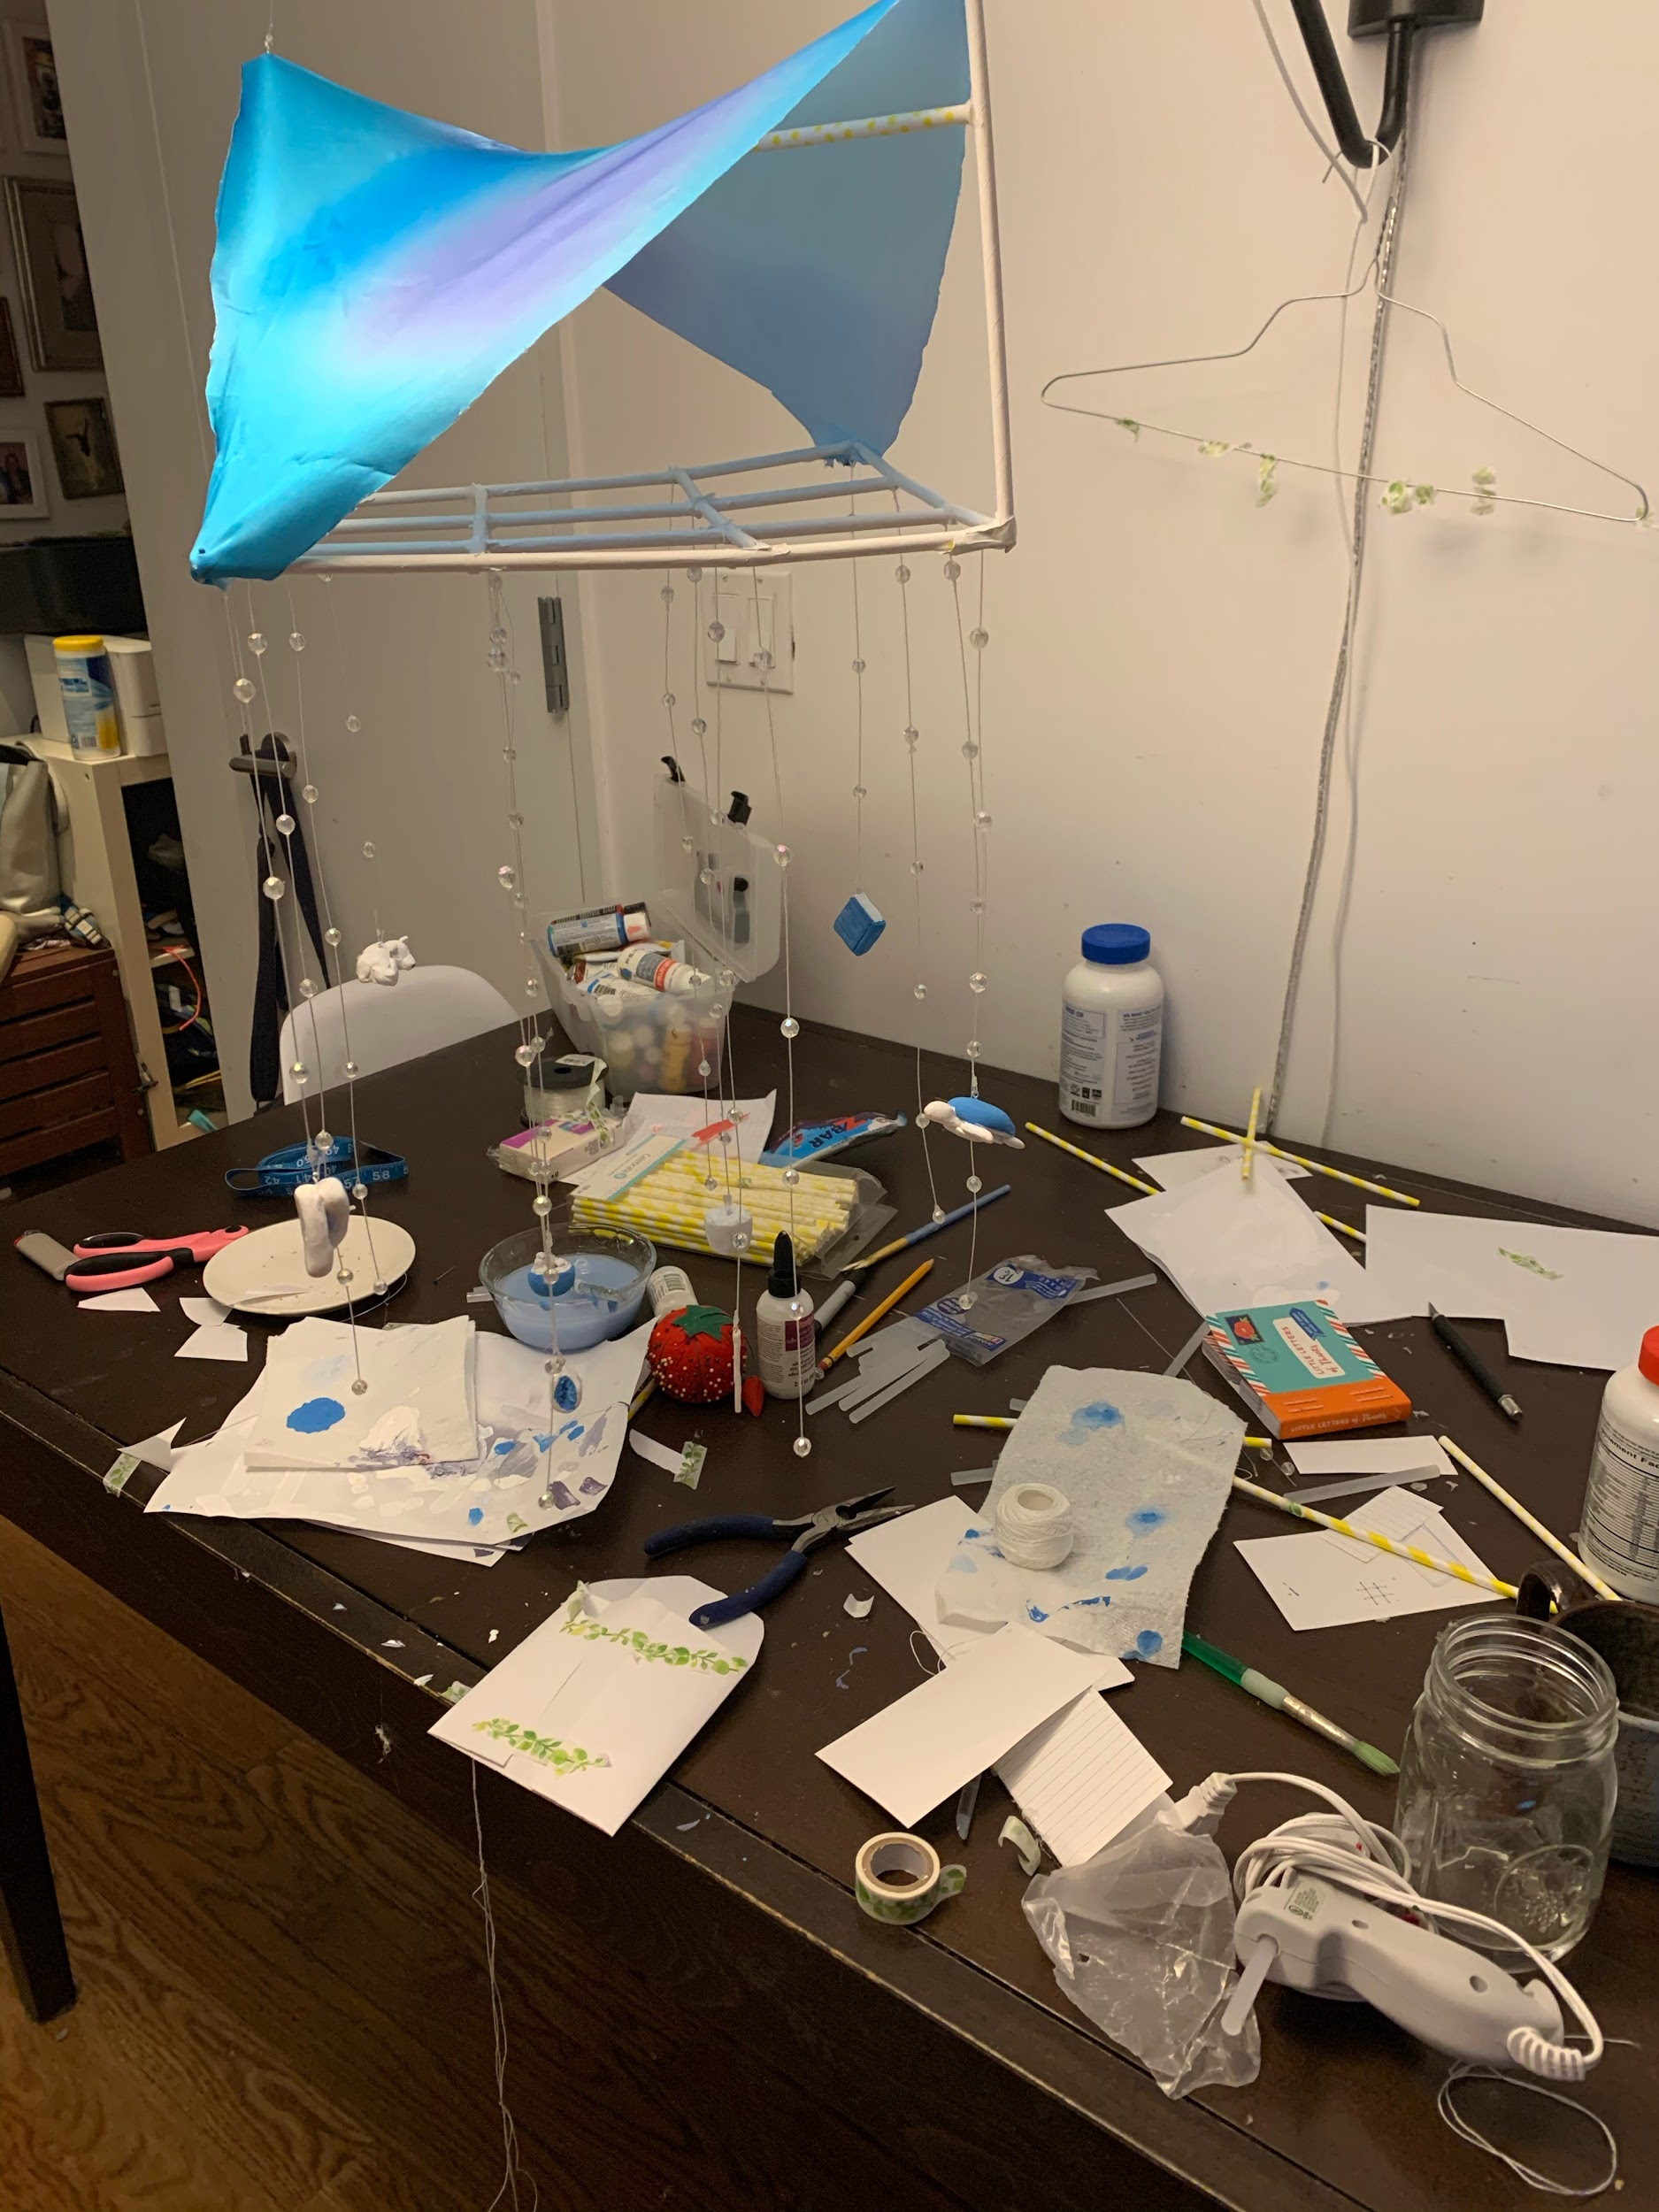
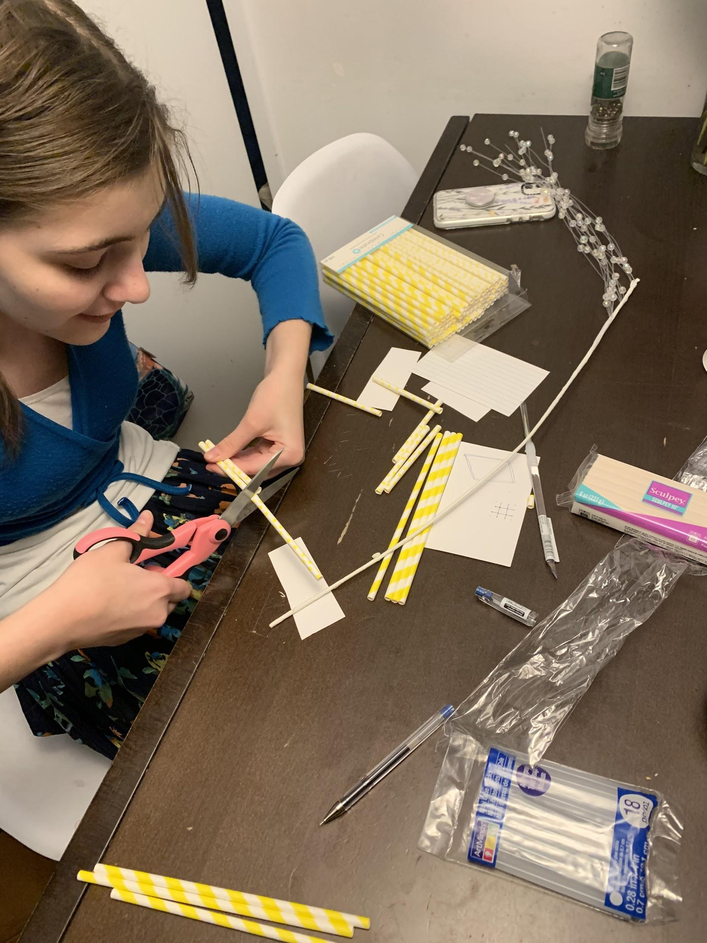
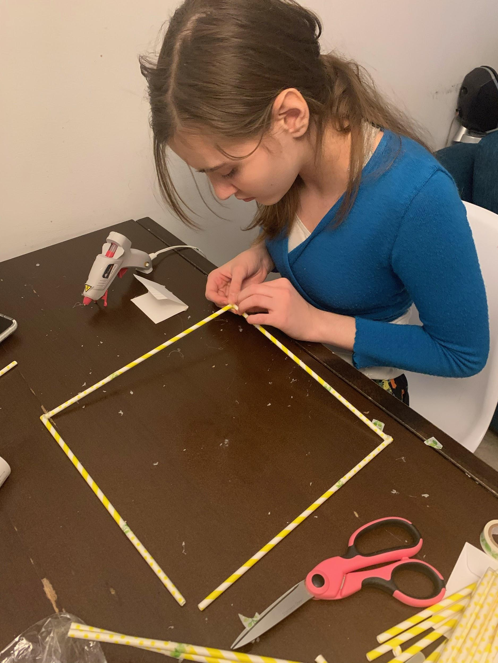
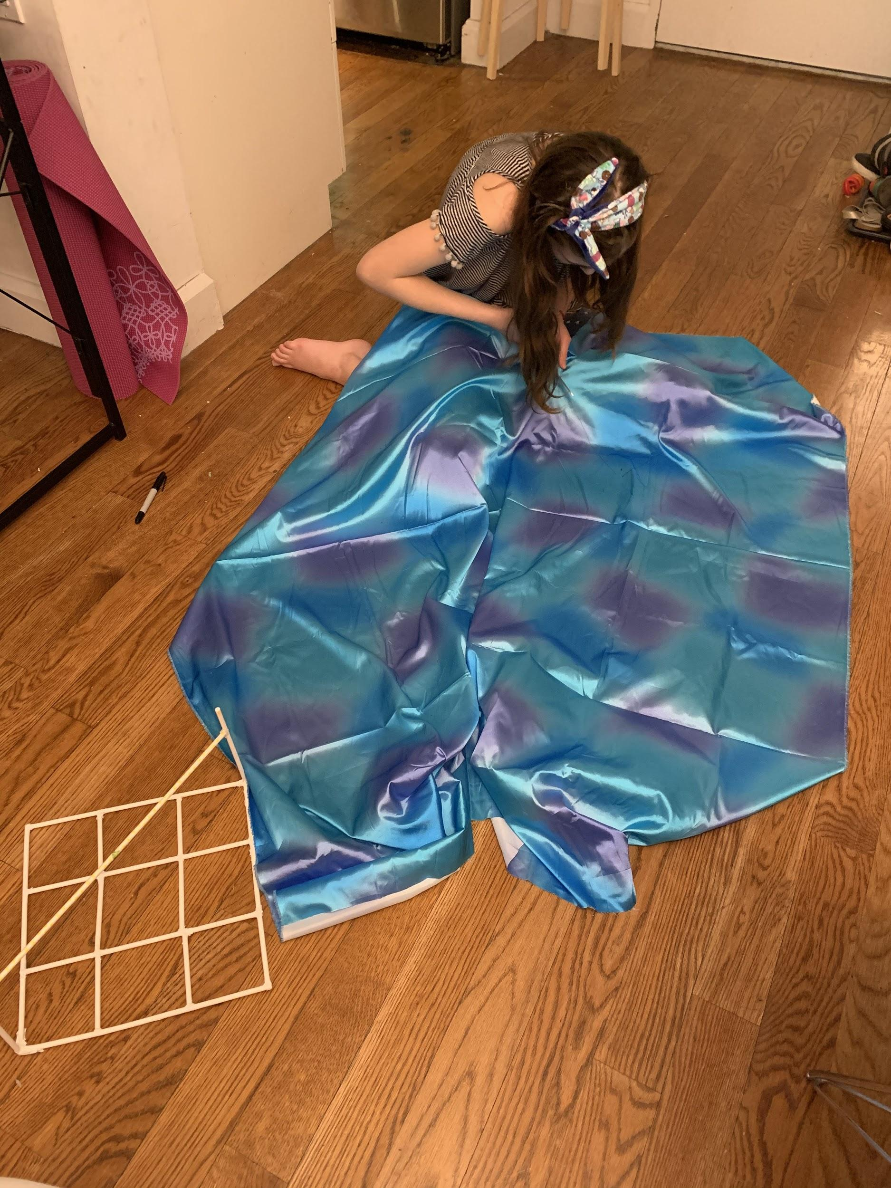
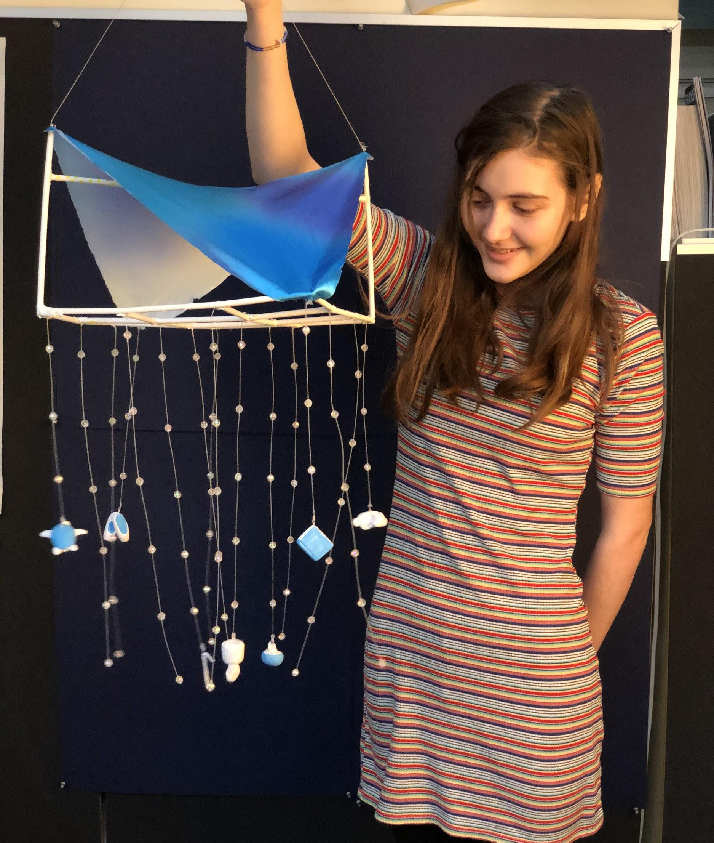
Progress Photos

Slide 8
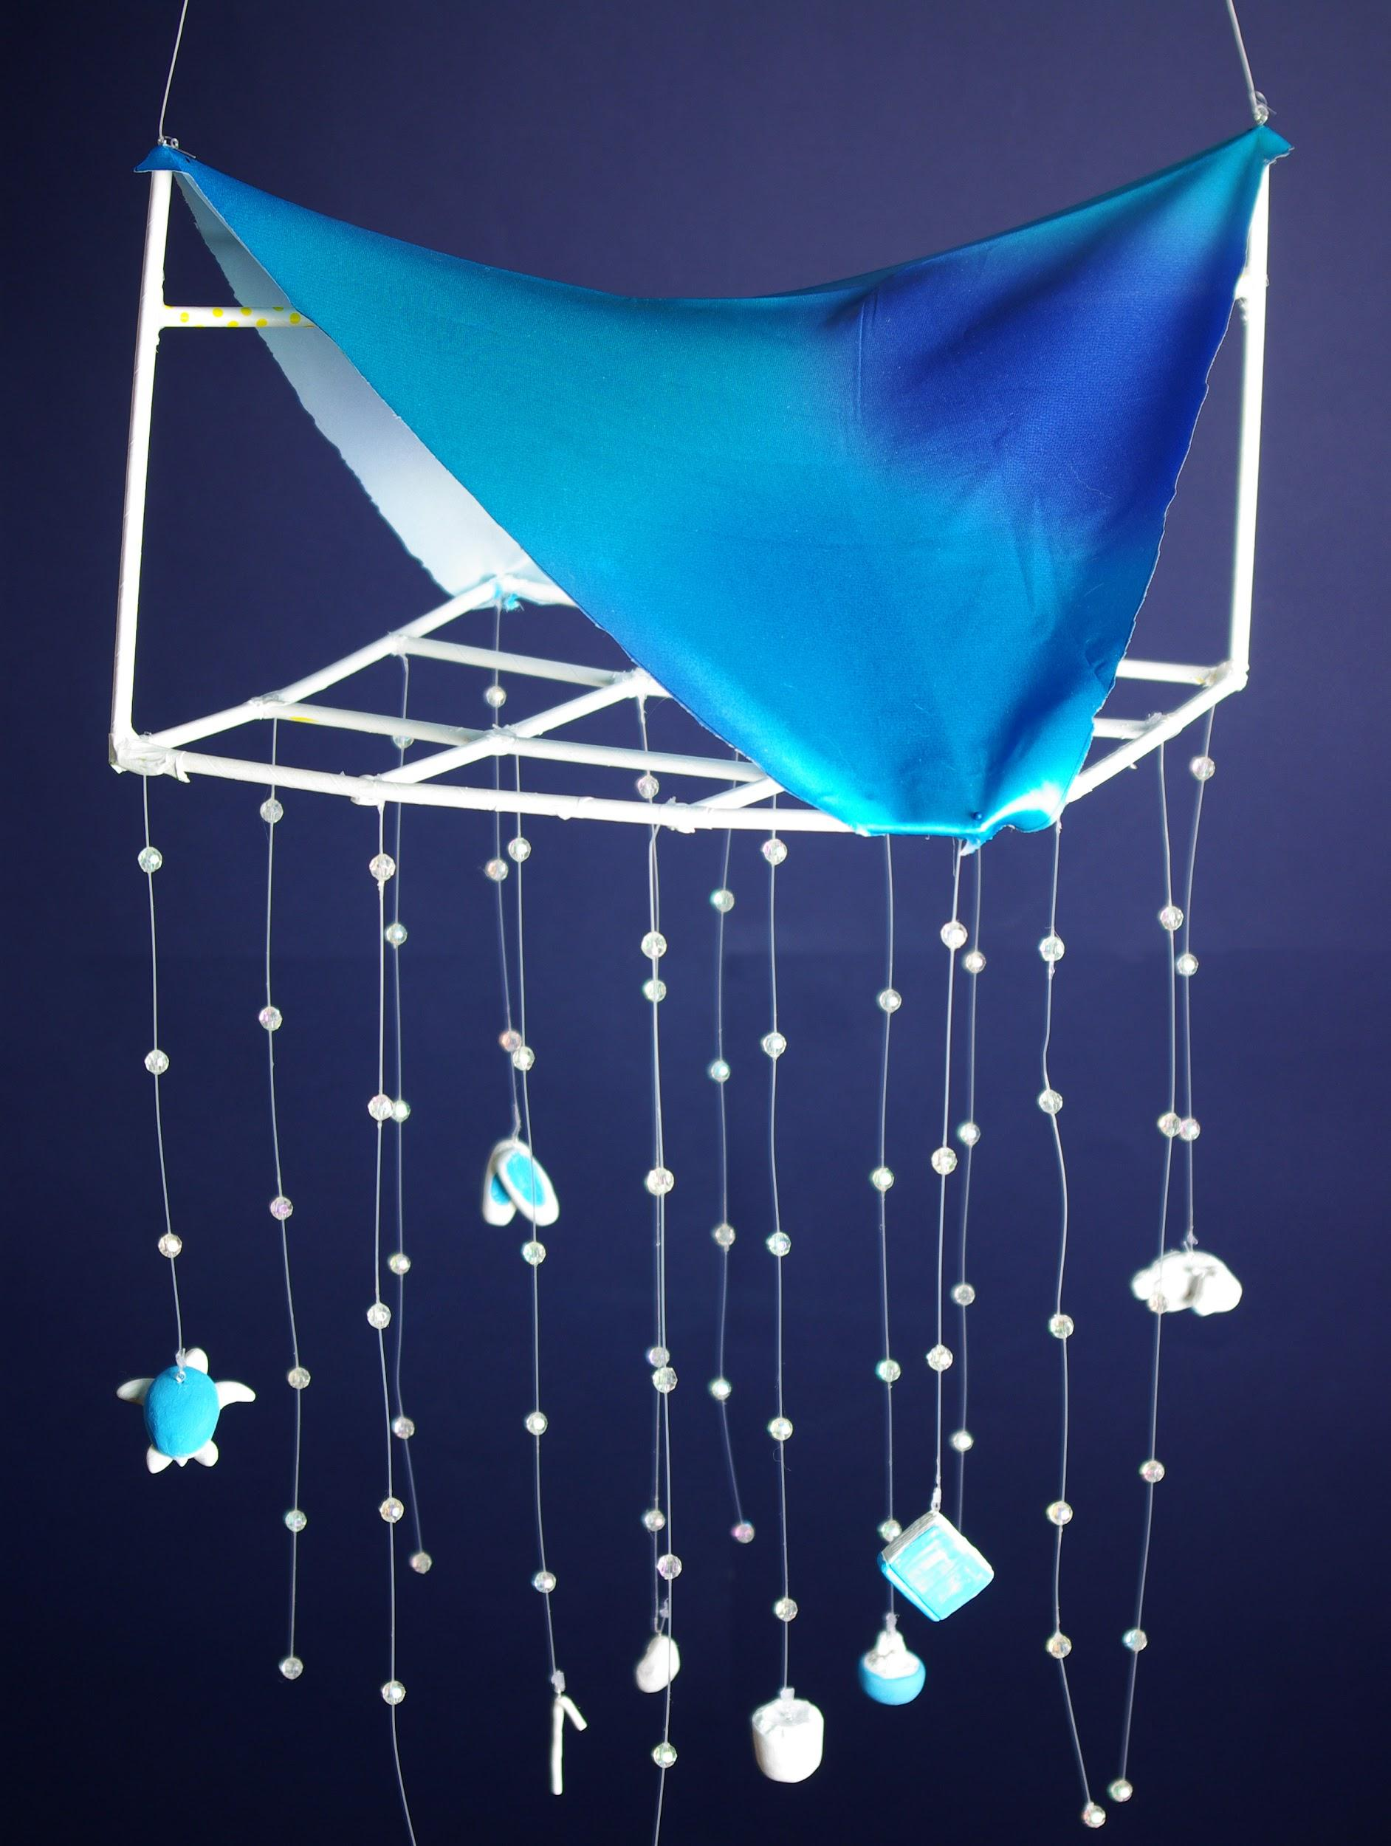
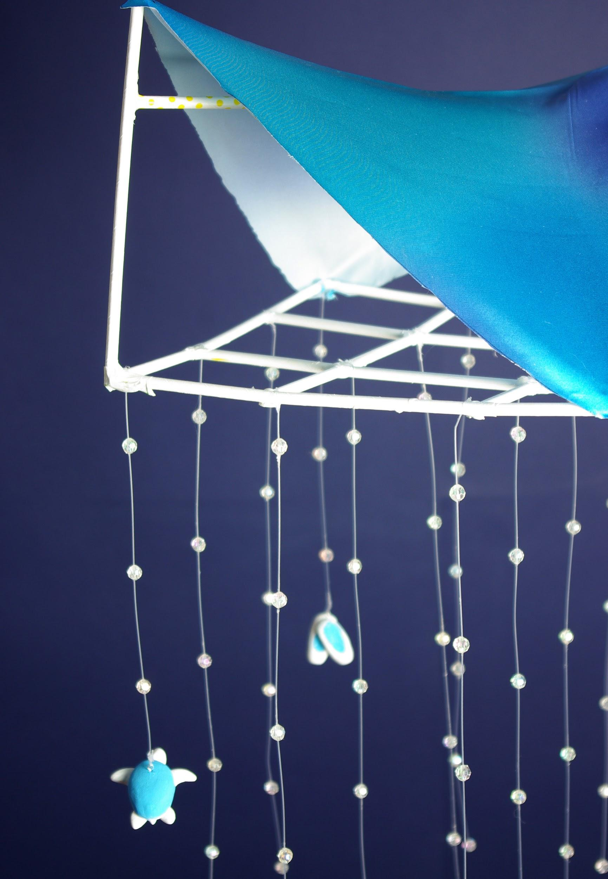
Final Product

Slide 9
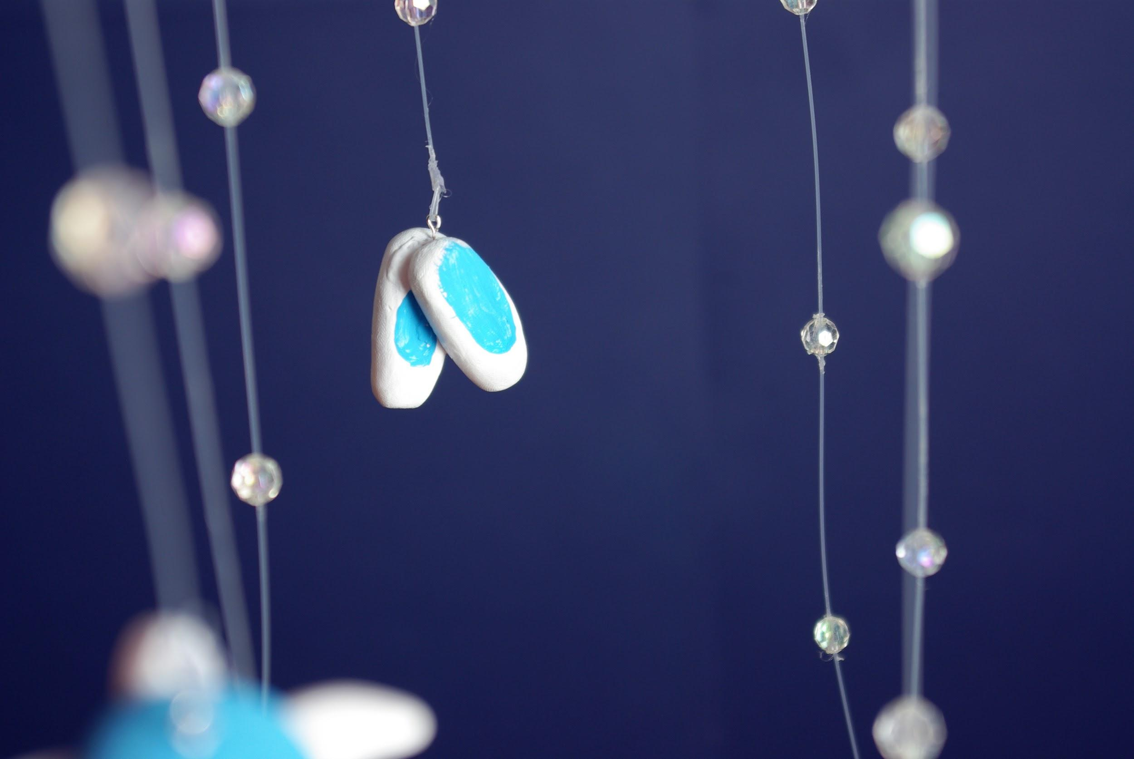
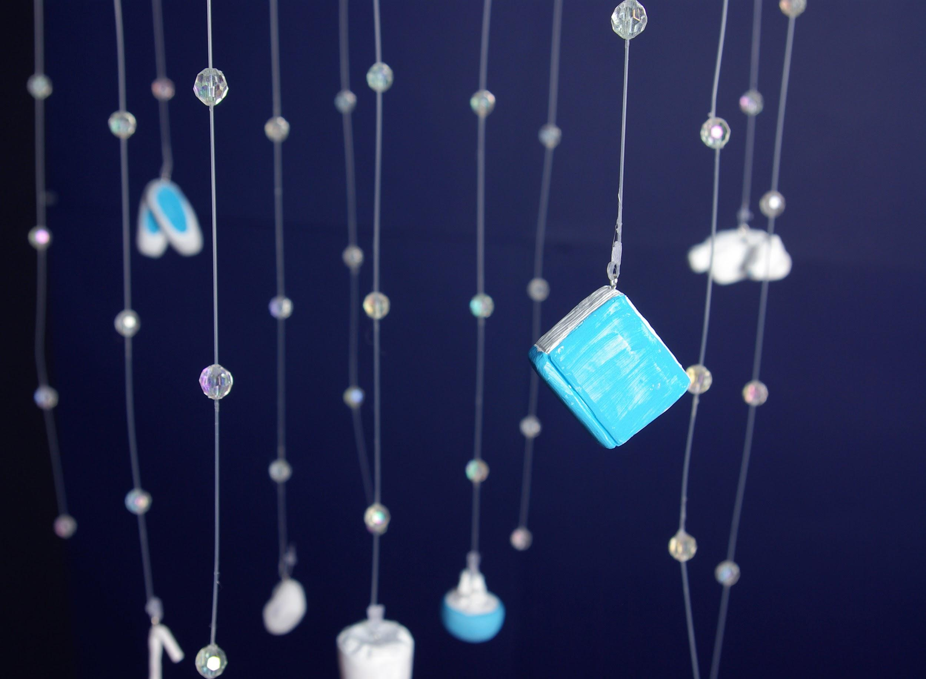
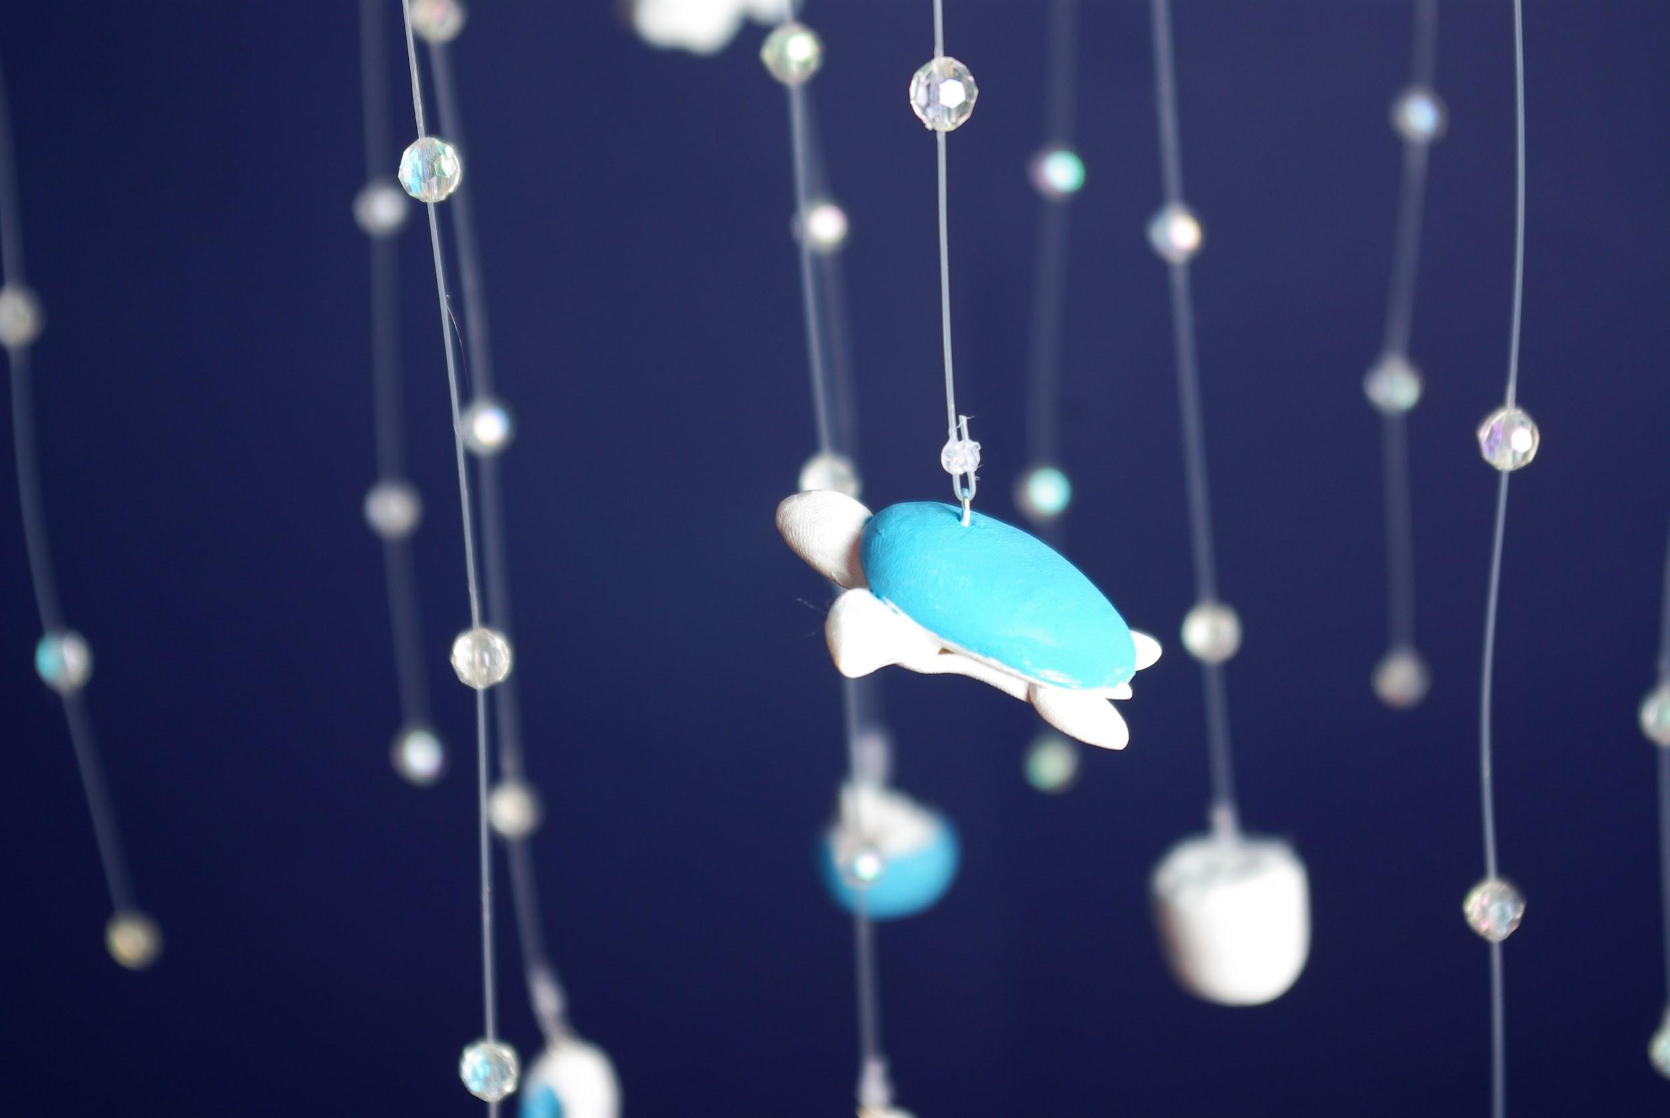
Final Product (Closeups)

Slide 10
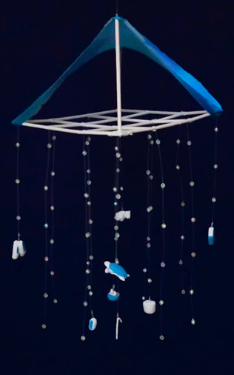
Final Product (Video)
Notes:
Video is ment to be silent, it’s the same as the spinning gif on the left.

Slide 11
Evelyn Durgin-Bruce - Final Product

Slide 12
Evelyn Durgin-Bruce

Slide 13
Evelyn Durgin-Bruce Artist Statement
For my project, I created a hanging mobile as a dimensional self-portrait inspired by Sol Lewitt’s work. Inspired by his grid arrangements, I created a hanging grid with dangling string and small clay replicas of objects that are meaningful to me, or things that represent my personality and interests. The objects are: a book, a sea turtle, my grandmother’s pointe shoes, my dog, a geode, a metal straw, a plant, and a candle from my summer camp.
Each of the objects has a story or meaning to it. For example, a sea turtle is my favorite animal; and my plant because I love nature. I included the pointe shoes, because I’m an avid ballet dancer, and it is something that is important to me. My great grandmother was a professional ballerina, and so was my grandmother. The pointe shoes are meant to represent my grandmother’s first pair of pointe shoes, which she handed down to me.
The story behind the candle is one of my favorites. I love lighting candles, and this one is from my summer camp and brings back lots of good memories. At the end of camp, we make candles and all go stand on the beach with them and light them. Each person goes around chipping off pieces of their candle, and putting it in each other’s candles. It’s a symbol of friendship, and sharing memories.
Environmental sustainability is also important to me, and is a theme that I put into this project. I included a metal straw in the objects because I carry around and use a metal straw daily to reduce the amount of plastic that I use. The white grid is also made of paper straws, as a way to recycle and repurpose them. In addition to the turtle, I think that the overall shape looks like a jellyfish.
The top of this project is inspired by tensile architecture, and looks a bit like a tent. The fabric is in my two favorite colors, a bright blue and purple. I’m very proud of how this project came out, and how the final product looks like a chandelier.

